Slide 2
What do you know about the Commission?

Slide 3
In this presentation…
European Commission
How it works
4 main roles
The Juncker Commission
Election process
10 priorities

Slide 4
The European Commission
1
2
3
is the political executive
acts as a college
promotes the general interest of the Union
Notes:
The European Commission:
Political executive:
- The European Commission is the EU's politically executive arm.
Follow-up questions:
-> What is the executive?
-> What is the executive in your home country?
2) Principle of collective responsibility (also called: collegiality):
- Decisions and actions by Commissioners are based on collective responsibility.
- In general, decisions by Commissioners are made by consensus, but votes by simple majority can also take place.
- All Commissioners are equal in the decision-making process and equally accountable for these decisions.
A Commssioner's profile:
- National of one EU Member State
- Competence in his/her portfolio
- European commitment
- Fully independent
Follow-up questions:
-> How does the principle of collective responsibility differ to how ministers in your own national government work?
3) General interest of the Union:
- The Commission promotes the general interest of the EU and takes appropriate initiatives to that end. (Lisbon Treaty, Art. 17)
- The Commissioners all swear a solemn declaration at the Court of Justice to be completely independent and to respect the EU treaties.
Follow up questions:
-> According to which interest does the president/ chancellor of your home country act?

Slide 5
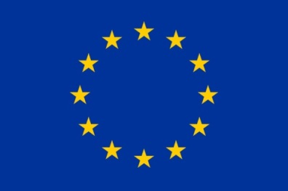
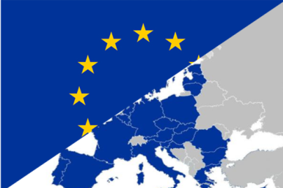
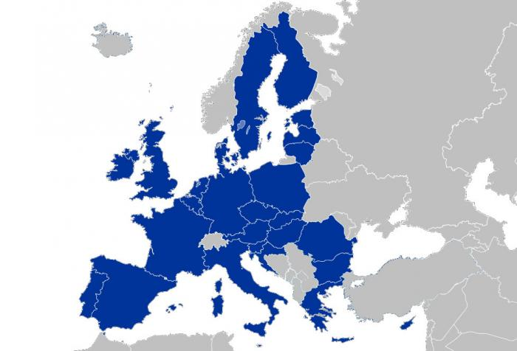
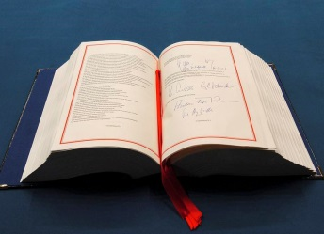
Taking decisions in the EU
Competences
Exclusive
- Trade
- Competition
Shared
Agriculture
Environment
Supporting
Tourism
Education

Slide 6
The 4 roles of the Commission
RIGHT OF INITIATIVE
POLICY & BUDGET IMPLEMENTATION
GUARDIAN OF THE TREATIES
INTERNATIONAL DIMENSION
Notes:
Example: proposal for a sustainable and fair Common European Asylum System
On 4 May, the European Commission presented proposals to reform the Common European Asylum System by creating a fairer, more efficient and more sustainable system for allocating asylum applications among Member States. The basic principle will remain the same – asylum seekers should, unless they have family elsewhere, apply for asylum in the first country they enter – but a new fairness mechanism will ensure no Member State is left with a disproportionate pressure on its asylum system.
Background:
Since 1999, the EU has been working to create a Common European Asylum System (CEAS) and improve the current legislative framework.
Asylum is granted to people fleeing persecution or serious harm in their own country and therefore in need of international protection. Asylum is a fundamental right; granting it is an international obligation, first recognised in the 1951 Geneva Convention on the protection of refugees.
In the EU, an area of open borders and freedom of movement, countries share the same fundamental values and States need to have a joint approach to guarantee high standards of protection for refugees. Procedures must at the same time be fair and effective throughout the EU and impervious to abuse. With this in mind, the EU States have committed to establishing a Common European Asylum System.

Slide 7
Initiating laws and policies
Voice of the EU
Proposals
Proposals
Citizens' voice
Member States' voice
Notes:
Initiating laws & policies
- The Commission has the right to propose new laws and policies on the matters contained in the treaties.
- It can also be asked to make a proposal – by the Council, the European Parliament, EU citizens, the European Investment Bank, European Central Bank and EU governments.
Institutional triangle
- There are 3 institutions responsible for EU law-making :
- European Commission
- European Parliament
- Council of the European Union
European Parliament
Tasks:
Adopts and negotiates, jointly with the Council of the EU, proposals for legislation put forward by the Commission (codecision)
Controls and approves, together with the Council of the EU, the EU budget
Oversees the work of the Commission
- Current term: 751 MEPs from 28 countries, elected for 5 years in May 2014.
Follow-up questions:
-> Who put the MEPs into office?
-> Who does the Parliament represent?
-> Who is the President of the Parliament?
Council of the European Union
Tasks:
Adopts and negotiates, jointly with the European Parliament, proposals for legislation put forward by the Commission (codecision)
Adopts, jointly with the European Parliament, the EU budget
Coordinates national policies
Develops the EU's common foreign and security policy, on the basis of guidelines set by the European Council
4.1) Ensures the unity, consistency and effectiveness, together with the High Representative, of the EU's foreign policy
Concludes international agreements
- Consists of national ministers from each EU country
- Its work is directed by a different EU member country every 6 months. The country doing this is said to hold the presidency of the Council
- To make this task easier, this country is helped by the preceding and successor presidency holders
- This group of 3 countries (the 'trio') works together closely, coordinating longer-term goals and preparing a common agenda of major issues to be addressed by the Council over an 18 month period.
Follow-up questions:
-> Who does the Council represent?
-> Who put the ministers into office?
Committee of the Regions
The Committee of the Regions (CoR) consists of representatives of regional and local government.
They are proposed by the Member States and appointed by the Council for a 5‑year term.
The Council and Commission must consult the CoR on matters of relevance to the regions, and it may also issue opinions on its own initiative.
European Economic and Social Committee
The European Economic and Social Committee (EESC) is a consultative body that gives representatives of Europe's socio-occupational interest groups and others, a formal platform to express their points of views on EU issues.
Its members are appointed by the Council for a 5-year term.
Its opinions are forwarded to the Council, the European Commission and the European Parliament.
Court of Justice
Located in Luxembourg, is made up of one judge from each EU country, assisted by eight advocates-general.
They are appointed by joint agreement of the governments of the Member States for a renewable term of 6 years.
The Court’s role is to ensure that EU law is complied with, and that the Treaties are correctly interpreted and applied.
Court of Auditors
The European Court of Auditors, located in Luxembourg, was established in 1975.
It checks that all the European Union’s revenue has been received and all its expenditure incurred in a lawful and regular manner and that the EU budget has been managed soundly.
It has one member from each EU country, appointed for a term of 6 years by agreement between the Member States following consultation of the European Parliament.

Slide 8
The 4 roles of the Commission
RIGHT OF INITIATIVE
POLICY & BUDGET IMPLEMENTATION
GUARDIAN OF THE TREATIES
INTERNATIONAL DIMENSION
Notes:
Example: EU-Turkey Agreement
On 18 March 2016, EU Heads of State or Government and Turkey agreed to end the irregular migration from Turkey to the EU and replace it instead with legal channels of resettlement of refugees to the European Union. The aim is to replace disorganised, chaotic, irregular and dangerous migratory flows by organised, safe and legal pathways to Europe for those entitled to international protection in line with EU and international law.
- The implementation of the Statement requires huge operational efforts from all involved, and most of all from Greece. Greece and Turkey are the two governments in charge of implementing the Statement. It is their authorities who have to do the legal and operational work.
-The Commission is assisting Greece with advice, expertise and support from the EU budget and by coordinating the support which is being provided by other Member States and EU agencies.
- The Commission estimated the costs of the practical implementation of the Statement to be around €280 million over the next six months and it was agreed that the EU budget should finance these costs.
- The EU will support Greece to put in place the necessary human resources, infrastructure and reception capacity in order to carry out registrations appeals processes and large scale return operations.

Slide 9
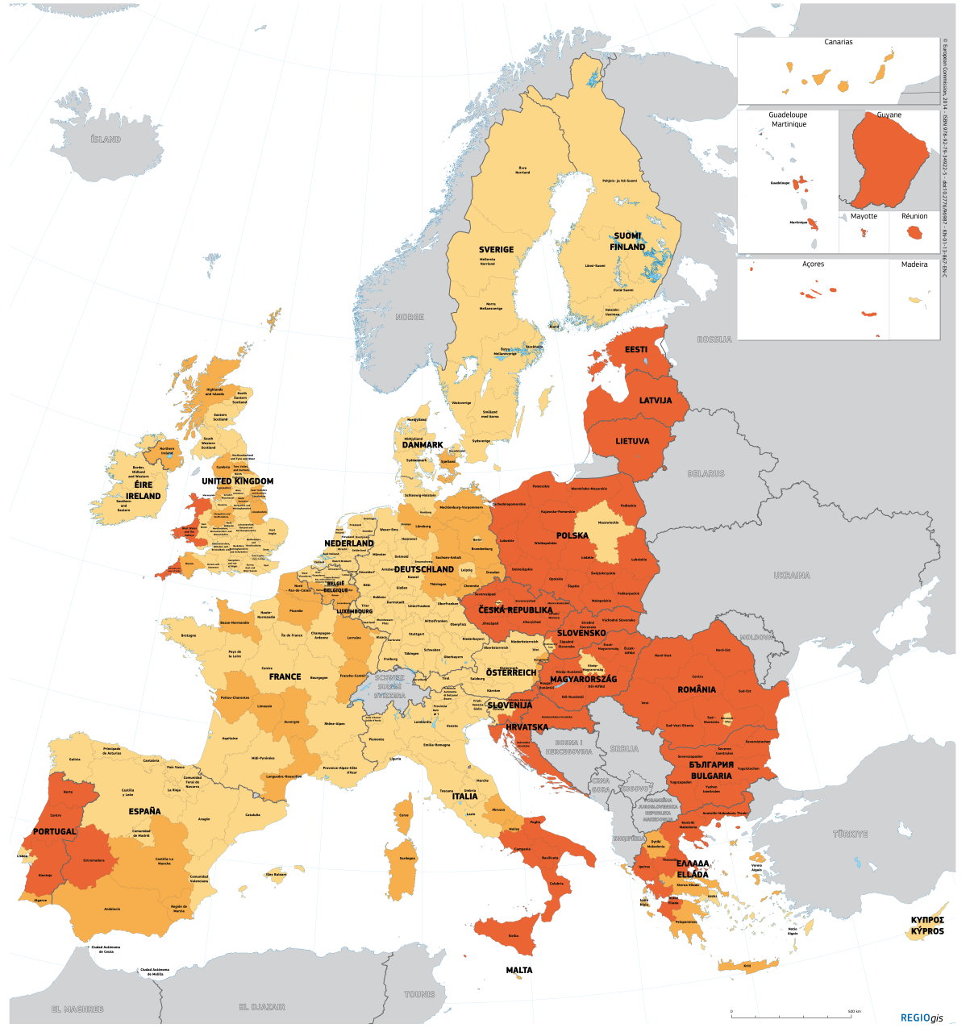
Implementing policies
Legend
Less developed regions
(GDP/head < 75% of EU-27 average)
Transition regions
(GDP/head between 75% and 90% of
EU-27 average)
More developed regions
(GDP/head >= 90% of EU-27 average)
Notes:
Policy Implementation
The Commission manages and implements EU policies.
Follow-up questions:
-> What is a policy?
Example: Regional Policy
Regional Policy targets all regions and cities in the European Union in order to support job creation, business competitiveness, economic growth, sustainable development, and improve citizens’ quality of life.
Its investments help to deliver many EU policy objectives and complements EU policies such as those dealing with education, employment, energy, the environment, the single market, research and innovation.
The European Structural and Investment Funds are directly contributing to the Investment Plan and the Commission's priorities.
The policy is implemented by national and regional bodies in partnership with the European Commission.
Cohesion policy
‘Cohesion policy’ is the policy behind the hundreds of thousands of projects all over Europe that receive funding
Economic and social cohesion – as defined in the 1986 Single European Act – is about ‘reducing disparities between the various regions and the backwardness of the least-favoured regions’. The EU's most recent treaty, the Lisbon Treaty, adds another facet to cohesion, referring to ‘economic, social and territorial cohesion’.
Cohesion policy covers every region in the EU. However, most of the funds are targeted where they are most needed: at regions with a GDP per capita under 75% of the EU average.
€ 351.8 billion – almost a third of the total EU budget – has been set aside for Cohesion Policy for 2014-2020.
Map: Structural Funds eligibility 2014 – 2020
Red: Less developed area (GDP/head < 75% of EU-27 average)
Orange: Transitional area (GDP/head between 75% and 90% of the EU-27 average)
Yellow: More developed regions (GDP/head >= 90% of EU-27 average)
Follow-up questions:
-> What other policies do you know which are executed by the Commission?

Slide 10
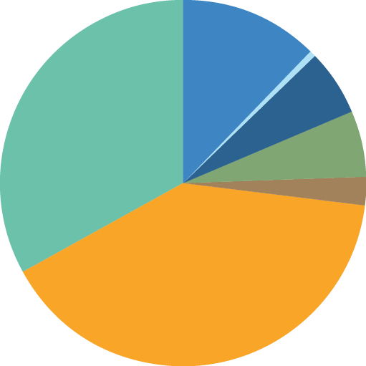
Spending on policies
Competitiveness for growth and jobs
€19 bn
Smart & inclusive growth:
education, energy, social policy, regional policy, etc.
€51 bn
Administration
€9 bn
Global Europe
€9 bn
Total budget
€155 bn
(2016)
Security and citizenship
€4 bn
Green growth:
agricultural policy, fisheries policy, environmental measures, etc.
€62 bn
Notes:
Budget:
The Commission draws up annual budgets for approval by the Parliament and Council.
The Commission sets EU spending priorities, together with the Council and Parliament.
The Commission supervises how the money is spent, under scrutiny by the Court of Auditors.
The Commission leads the execution of the full budgetary cycle.
Total budget (2016): €155 bn in total commitments.
The budget is results-oriented; it is not an accounting tool, but a means to achieve the EU's political goals, e.g.:
Creating jobs via Juncker's Investment Plan
More sustainable, secure and affordable energy via the Energy Union strategy
Tackling the refugee crisis via the Agenda on Migration
Pie chart:
Over 94% of the EU budget goes to citizens, regions, cities, farmers and businesses.
The EU's administrative expenses account for under 6% of the total EU budget, with salaries accounting for around half of that 6%.
The EU budget stands at about 1% of the 28 EU countries' gross domestic product (GDP) – the total value of all goods and services produced in the EU. By contrast, the budgets of EU countries represent 49% of GDP on average.

Slide 11
The 4 roles of the Commission
RIGHT OF INITIATIVE
POLICY & BUDGET IMPLEMENTATION
GUARDIAN OF THE TREATIES
INTERNATIONAL DIMENSION
Notes:
Example: 9 infringement proceedings against Member States
10 February 2016: The Commission issued reasoned opinions against Member States in 9 infringement cases concerning their non-transposition of the Common European Asylum System. The decisions concern Germany (2 cases), Estonia, Slovenia (2 cases), Greece, France, Italy and Latvia.
All 9 cases concern the non-transposition of directives that would contribute to a greater convergence between the national asylum systems. The reduction in divergences between national asylum systems plays a role in reducing secondary movements among asylum seekers who would otherwise be influenced by differences in the asylum rules in different Member States.

Slide 12
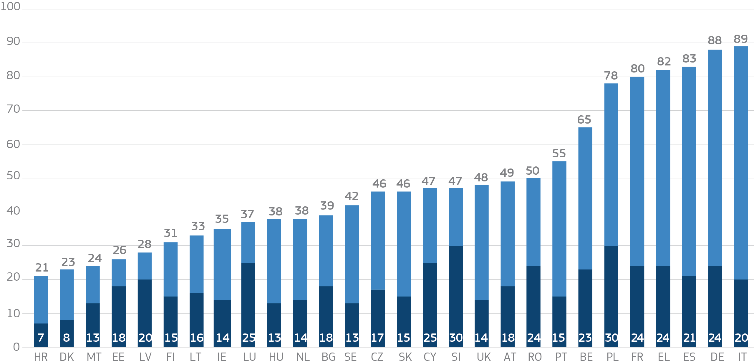
Guardian of the treaties / Member States
Number of infringement cases in EU-28 in 2015
Top figures: Total number of infringements
Infringements for incorrect transposition and/or bad application of EU laws
Late transposition infringements
Notes:
Guardian of the Treaties
The Commission ensures that the EU treaties and the laws derived from them are upheld.
If a possible infringement of EU law is identified by the Commission or reported in a complaint, the Commission attempts to quickly resolve the underlying problem with the government concerned by means of a structured dialogue.
If the government does not agree with the Commission, or fails to implement a solution to rectify the suspected violation of EU law, the Commission can launch a formal infringement procedure.
This can involve the Commission taking the country to the Court of Justice and ask to impose lump sum and/or penalty payment.
Example: Open infringement cases in EU-28 on 31 December 2015

Slide 13
Guardian of the treaties – companies
(April 2016)
Antitrust proceeding
Notes:
Guardian of the Treaties
The Commission ensures that the EU treaties and laws are upheld.
If a possible infringement of EU law by a company is identified by the Commission or reported in a complaint, the Commission attempts to quickly resolve the underlying problem with the company concerned by means of a structured dialogue.
If the company does not agree with the Commission or fails to implement a solution to rectify the suspected violation of EU law, the Commission can launch formal infringement procedure.
The Commission can take companies to the Court of Justice in dispute.
Example: Companies - Google
Google holds around 90% of the market share for internet search services in most European Economic Area (EEA) countries, and several companies have complained to the European Commission about Google's market dominance. The European Commission has thus formally launched two separate investigations, one on Google's comparison shopping and the other on the company's handling of applications installed on Android operating mobile devices.
In April 2015, the Commission sent a Statement of Objections to Google, indicating that the company had abused its dominant position in the European Economic Area (EEA). Google admits that it is dominant, thanks to its innovative products and services, but does not agree that it has abused its position on the market.
The Google case may provide an opportunity for the Commission to clarify some aspects of competition law with regard to certain digital practices, and to close the difficult gap between the rights of companies who dominate the market, free competition and consumer protection.
Competition policy
Competition policy has always been an important policy area for the European Union. Antitrust regulations were implemented in order to guarantee free trade and fair competition in the common single market.
The total amount of fines imposed since 1990 is €20.4 billion, with more than three quarters of that figure, around €16.6 billion, charged between 2005 and 2014.
Over recent years, the Commission has opened several cases against, inter alia: Microsoft (conditions of access to their operating system); IBM (conditions of supply of computer maintenance to third parties); and Apple (use of nonproprietary software development tools).
Follow-up questions:
-> Do you know of any other famous infringement procedures?

Slide 14
The 4 roles of the Commission
RIGHT OF INITIATIVE
POLICY & BUDGET IMPLEMENTATION
GUARDIAN OF THE TREATIES
INTERNATIONAL DIMENSION
Notes:
Example: EU-Turkey Agreement
On 18 March 2016, EU Heads of State or Government and Turkey agreed to end the irregular migration from Turkey to the EU and replace it instead with legal channels of resettlement of refugees to the European Union. The aim is to replace disorganised, chaotic, irregular and dangerous migratory flows by organised, safe and legal pathways to Europe for those entitled to international protection in line with EU and international law.
Example: Meeting on the Western Balkans Migration Route: Leaders Agree on 17-point plan of action
On 25 October 2015, Leaders representing Albania, Austria, Bulgaria, Croatia, the former Yugoslav Republic of Macedonia, Germany, Greece, Hungary, Romania, Serbia and Slovenia met in Brussels at the Commission's Berlaymont Headquarters and agreed on a 17-point plan of action to improve cooperation and step up consultation between the countries along the route and decided on pragmatic operational measures that can be implemented to tackle the refugee crisis in the region.
Example: G7 summit Japan - tackling the global migration challenge
On 26-27 May 2016, Japan hosted the meeting of the G7 leaders. The summit focused on the global economy, foreign policy and the migration and refugee crisis. Donald Tusk, President of the European Council, and Jean-Claude Juncker, President of the European Commission, represented the EU at the summit. The G7 called for a global response to the crisis. Leaders committed to increase global assistance to meet the needs of refugees and their host communities. They called on financial institutions and bilateral donors to bolster their assistance. They also agreed to enhance legal channels for migration and encouraged the establishment of resettlement schemes.

Slide 15
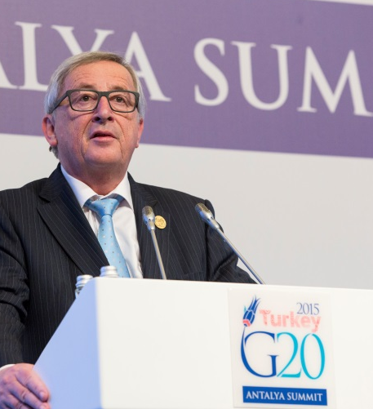
Representing the EU in the world
The EU's
foreign policy
The European
Union's diplomatic service
International
agreements
EU's assistance
to developing countries
Notes:
The EU's foreign policy:
President Juncker represents the Commission during G7 and G20 summits and bilateral summits with third countries.
The EEAS:
The EEAS is the European Union's diplomatic service.
It is led by Federica Mogherini, the EU's High Representative for Foreign Affairs and Security Policy, who is responsible for coordinating and carrying out the EU's foreign and security policy.
Furthermore as Vice-President of the Commission, Mogherini ensures that the EU's external action is consistent across all departments and policy areas.
Formally launched in 2011, the EEAS was created by the Treaty of Lisbon which entered into force on 1 December 2009.
The EEAS manages the EU's response to crises, has intelligence capabilities and cooperates with the Commission in areas where they share power.
Cooperation between the Commission and the EEAS:
The European Commission cooperates with the EEAS on many issues – adopting a comprehensive approach for the EU's foreign policy.
- E.g. this is the case when it comes to EU's assistance to developing countries ('development aid'). But the EEAS is structurally and financially independent from the Commission.
The Commission retained control over its powers in aid (and the €6 billion a year budget for that), development, energy and enlargement (helping potential new member countries to join). This gives the relevant Commissioners the lead in those areas, and they deputise for the HR when necessary.
International agreements
The Commission represents the EU during negotiations, except where the agreement relates to foreign and security policy, when the EU is represented by the High Representative.
EU's assistance to developing countries
The Commission's Directorate-General for International Cooperation and Development (DG DEVCO) is responsible for designing European international cooperation and development policy and delivering aid throughout the world.
DG DEVCO is in charge of development cooperation policy in a wider framework of international cooperation, adapting to the evolving needs of partner countries. This encompasses cooperation with developing countries at different stages of development, including with countries graduated from bilateral development assistance to cover the specific needs of these countries during the transition period between low income countries and upper middle income countries. DG DEVCO works closely with other Commission services responsible for thematic policies, as well as with the European External Action Service and Commission services on external action, so as to facilitate and help ensure a consistent approach.
DG DEVCO is responsible for formulating European Union development policy and thematic policies in order to reduce poverty in the world, to ensure sustainable economic, social and environmental development and to promote democracy, the rule of law, good governance and the respect of human rights, notably through external aid. DG DEVCO fosters coordination between the European Union and its Member States in the area of development cooperation and ensure the external representation of the European Union in this field.
Follow-up question:
-> Do you know any other examples in the international dimension where the European Commission plays an important role internationally?

Slide 16
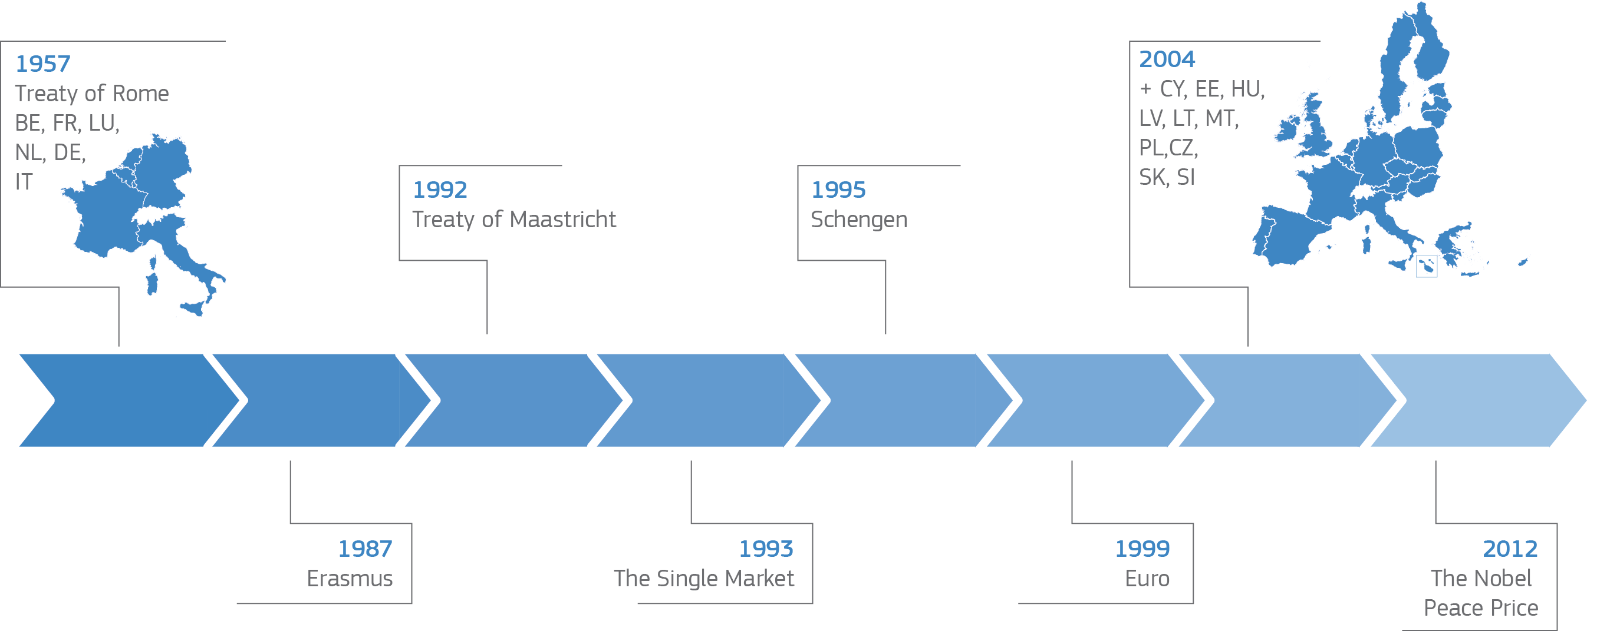
From achievements of the past
Notes:
1957: Treaty of Rome
Signed: 25 March 1957 Entered into force: 1 January 1958
Purpose: to set up the European Economic Community (EEC) and the European Atomic Energy Community (Euratom).
1987: ERASMUS
The ERASMUS student exchange programme is established in 1987.
1992: Treaty of Maastricht
Signed: 7 February 1992 Entered into force: 1 November 1993
Purpose: to prepare for European Monetary Union and introduce elements of a political union (citizenship, common foreign and internal affairs policy).
Main changes: establishment of the European Union and introduction of the co-decision procedure, giving Parliament more say in decision-making. New forms of cooperation between EU governments – for example on defence and justice and home affairs.
1993: The Single Market
The Single Market refers to the EU as one territory without any internal borders or other regulatory obstacles to the free movement of goods and services.
A functioning Single Market stimulates competition and trade, improves efficiency, raises quality, and helps cut prices. The European Single Market is one of the EU’s greatest achievements.
It has fuelled economic growth and made the everyday life of European businesses and consumers easier.
1995: Schengen
Schengen Agreements started in 1995, initially involving seven EU States.
The free movement of persons is a fundamental right guaranteed by the EU to its citizens. It entitles every EU citizen to travel, work and live in any EU country without special formalities.
Schengen cooperation enhances this freedom by enabling citizens to cross internal borders without being subjected to border checks.
The border-free Schengen Area guarantees free movement to more than 400 million EU citizens, as well as to many non-EU nationals, businessmen, tourists or other persons legally present in the Schengen area.
1999: Euro
In 1999 the currency was born virtually and in 2002 notes and coins began to circulate.
The euro is the single currency shared by 19 of the European Union's Member States, which together make up the euro area. The introduction of the euro in 1999 was a major step in European integration. It has also been one of its major successes: more than 337.5 million EU citizens in 19 countries now use it as their currency and enjoy its benefits.
2004: Enlargement
The 2004 enlargement of the EU was the largest single expansion of the EU, in terms of territory, number of states, and population to date.
2012: The Nobel Peace Price
The EU receives the Nobel Peace Prize for advancing the causes of peace, reconciliation, democracy and human rights in Europe.
The EU decided to dedicate the prize money (€930,000) to children growing up in conflict situations, and to provide a matching amount, to bring the donation to €2 million. As a result, more than 28,000 children have so far benefited from the 4 emergency-education projects selected last year.

Slide 17
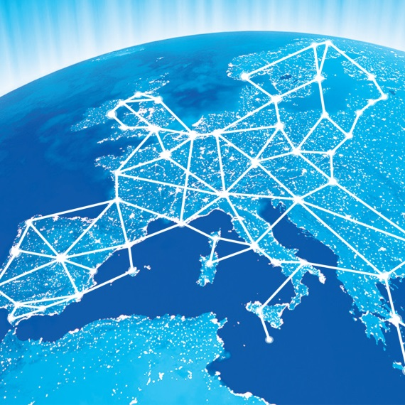
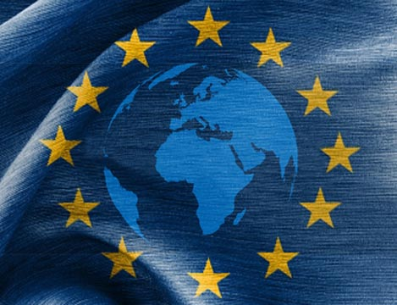
….to the challenges of today
#EnergyUnion
#EUGlobalStrategy
#DigitalSingleMarket
Notes:
Energy Union
The EU imports more than half of all the energy it consumes. Its import dependency is particularly high for crude oil (more than 90%) and natural gas (66%). The total import bill is more than €1 billion per day.
Many countries are also heavily reliant on a single supplier, including some that rely entirely on Russia for their natural gas. This dependence leaves them vulnerable to supply disruptions, whether caused by political or commercial disputes, or infrastructure failure. For instance, a 2009 gas dispute between Russia and transit-country Ukraine, left many EU countries with severe shortages.
The Energy Union means making energy more secure, affordable and sustainable.
It allows a free flow of energy across borders and a secure supply in every EU country, for every European.
New technologies and renewed infrastructure cut household bills and create new jobs and skills, as companies expand exports and boost growth.
It leads to a sustainable, low carbon and environmentally friendly economy, putting Europe at the forefront of renewable energy production and the fight against global warming.
EU Global Strategy
High Representative Federica Mogherini presented the EU Global Strategy on foreign and security policy to EU leaders meeting in Brussels at the EU summit on 28 June 2016.
Mogherini was mandated to prepare the new strategy by the European Council in June 2015 and invited to present it to leaders in June of this year. The strategy is the result of an open and transparent process: over the past year, extensive consultations took place with the EU Member States, the European institutions (including the European Commission and the European Parliament), and European civil society at large, including think thanks.
The strategy, under the title Shared Vision, Common Action: A Stronger Europe, has been elaborated under the leadership of the High Representative. It reflects the collective views expressed in the process and offers a strategic vision for the EU’s global role. In these challenging times, both for Europe and globally, the strategy highlights common ground and presents a common way forward.
Digital Single Market
Europeans often face barriers when using online tools and services. This is even though the EU has spent decades bringing down those barriers.
Fragmentation and barriers that do not exist in the physical single market are holding the EU back.
Markets for online service are largely domestic. Only 7% of EU small- and medium-sized businesses sell across borders. This needs to change – the single market needs to be a reality online, as well as on the ground.
In a digital single market, there are fewer barriers, and more opportunities: it is a borderless area where people and businesses can trade, innovate and interact legally, safely, securely, and affordably - making their lives easier.
The digital single market could contribute €415 billion a year to the European economy.
It can expand markets and foster more and better services at better prices.
It can create opportunities for new start-ups and allow existing companies to grow and profit within a market of over 500 million people.
A completed digital single market will also ensure that Europe maintains its position as a world leader in the digital economy, helping European companies to grow globally, and transforming our public services.

Slide 18
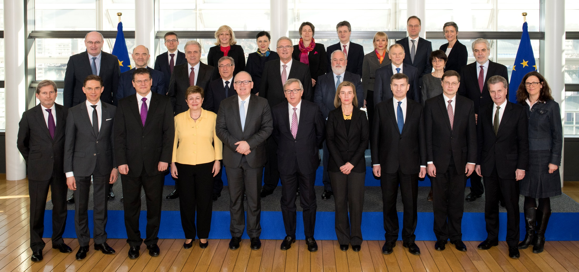
Juncker Commission (2014-2019)
Notes:
To introduce the current Commission

Slide 19
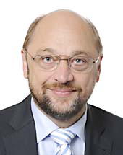
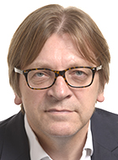
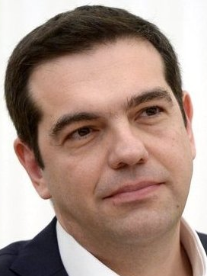
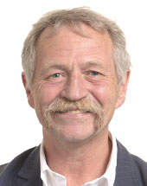
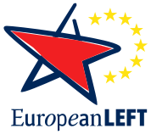
European Parliament elections 2014
Notes:
To explain the Parliament elections, Juncker's presidency and the composition of his team
European Parliament Elections 2014
22-25 May 2014: 8th parliamentary election since first direct elections held in 1979.
Spitzenkandidaten:
Jean-Claude Juncker (European People's Party)
Martin Schulz (Party for European Socialists)
Guy Verhofstadt (Alliance of Liberals and Democrats for Europe)
Ska Keller & José Bové (European Green Party)
Alex Tsipras (Party of the European Left)
- European People's Party won 214 out of 751 seats -> most seats for one party.
Follow-up question:
-> Why is the election of the European Parliament of importance for the European Commission?

Slide 20
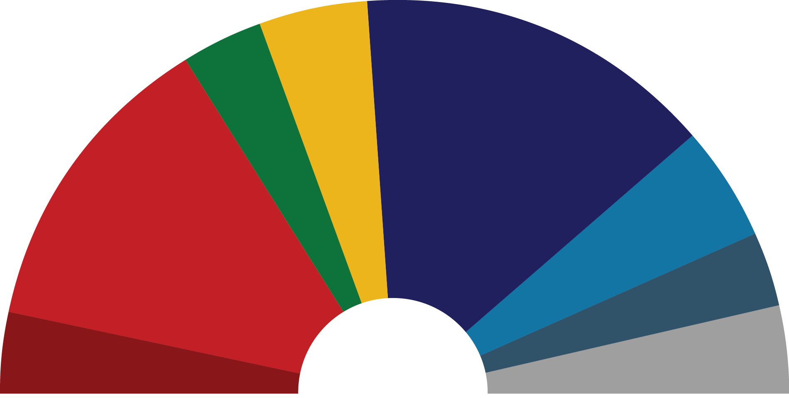
European Parliament elections 2014
67 ALDE
EPP 221
50 Greens/EFA
191 S&D
ECR 70
EFDD 48
52 GUE/NGL
751
NI 52
Notes:
To explain the outcome of the European Parliament Elections 2014, Juncker's presidency and the composition of his team.

Slide 21
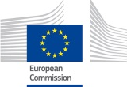
How President Juncker was elected
1
2
Heads of state and governments
Candidate nominated by the heads of state and governments taking into account the outcome of the European Parliament's election.
Candidate elected by the European Parliament
after the presentation of his programme.
Candidates
Candidate for becoming
the Commission's president
Notes:
The general election process:
A new team of 28 Commissioners (one from each EU Member State) is appointed every 5 years.
The candidate for President of the Commission is proposed to the European Parliament by the European Council, deciding by qualified majority and taking into account the elections to the Parliament (Treaty on European Union, Art. 17).
A qualified majority is reached if two conditions are met:
1) 55% of member states vote in favour - in practice this means 16 out of 28.
2) The proposal is supported by member states representing at least 65% of the total EU population.
The Commission President is then elected by the Parliament by a majority of MEPs (at least 376 out of 751 votes).
Following this election, the President-elect selects the 27 other Commissioners , on the basis of the suggestions made by member countries.
The final list of Commissioners-designate has then to be agreed between the President-elect and the Council.
The Commission as a whole needs the Parliament's consent. Before this, Commissioners-designate are assessed by the Parliament committees in specific hearings.
Juncker's election process (2014):
May : EPP wins most seats in the European Parliament.
June: European Council nominates Juncker for Commission President.
July: Parliament confirms Juncker, based on his 10 priorities, presented during his speech "A New Start for Europe: My Agenda for Jobs, Growth, Fairness and Democratic Change".
October: European Council formally appoints the new Commission.
November: new team of Commissioners, headed by Juncker, assumes office.
Follow-up questions:
-> What are the tasks of the European Commission's President?
-> How is this election process different to the ones before?

Slide 22
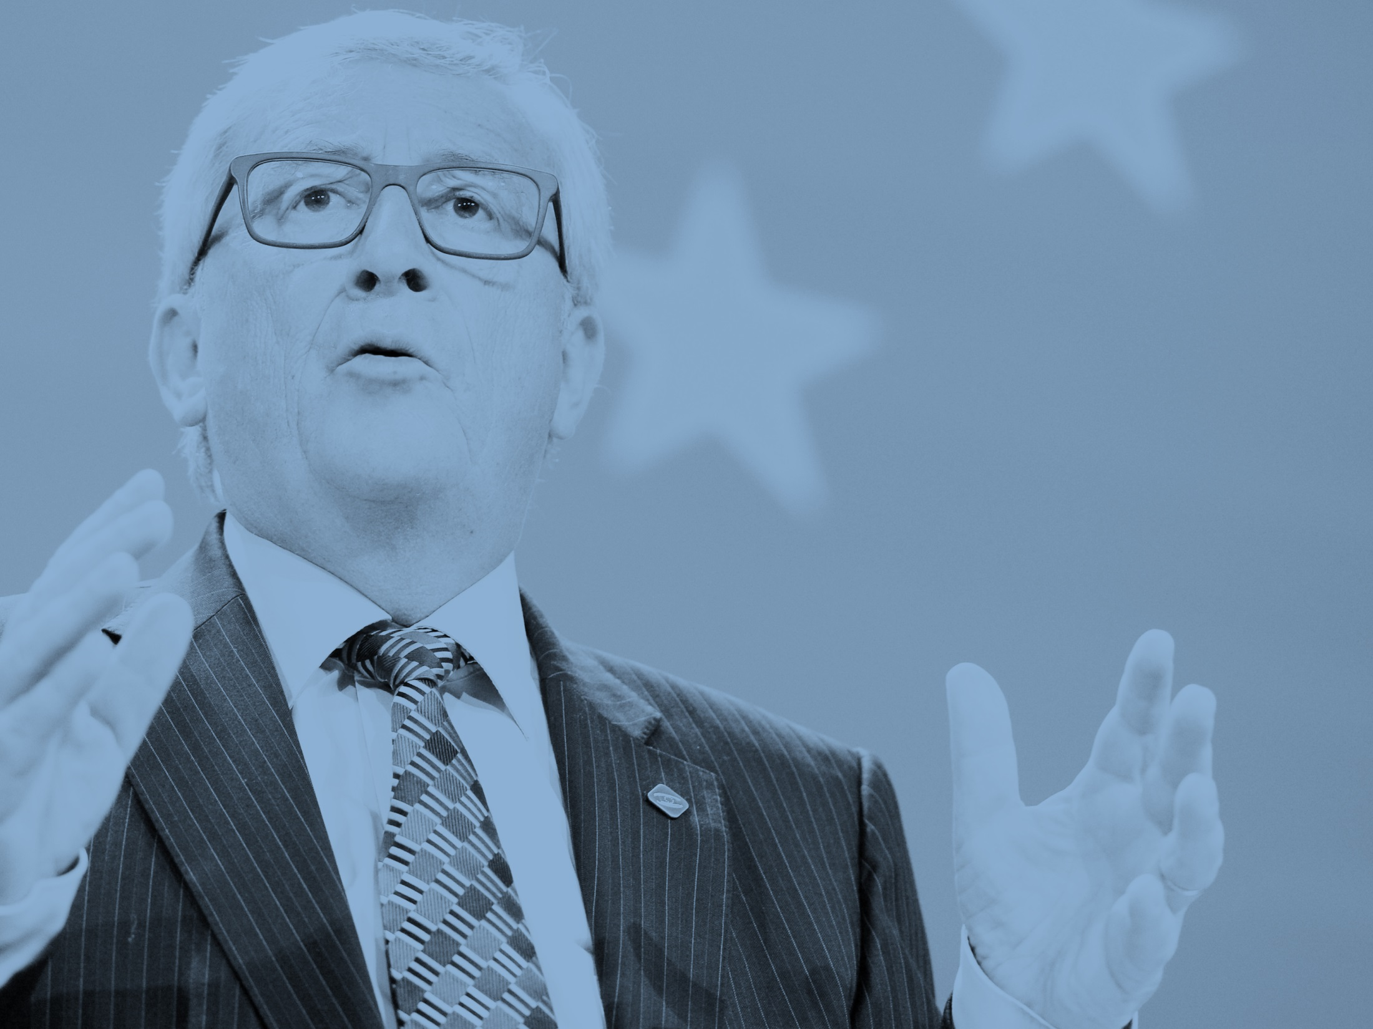
"My first priority as Commission President will be to strengthen Europe's competitiveness
and to stimulate investment for the purpose of job creation."
President Jean-Claude Juncker
Strasbourg, 15 July 2014
Notes:
To introduce the 10 priorities and explain the overall objective (priority 1) of making Europe more competitive, stimulating investment and creating new jobs.
To explain that most of the 10 priorities support the objectives of priority 1.
July 2014: Juncker presents the priorities for his term of office in the Parliament.
Speech: "A new start for Europe: My agenda for Jobs, Growth, Fairness and Democratic Change".

Slide 23
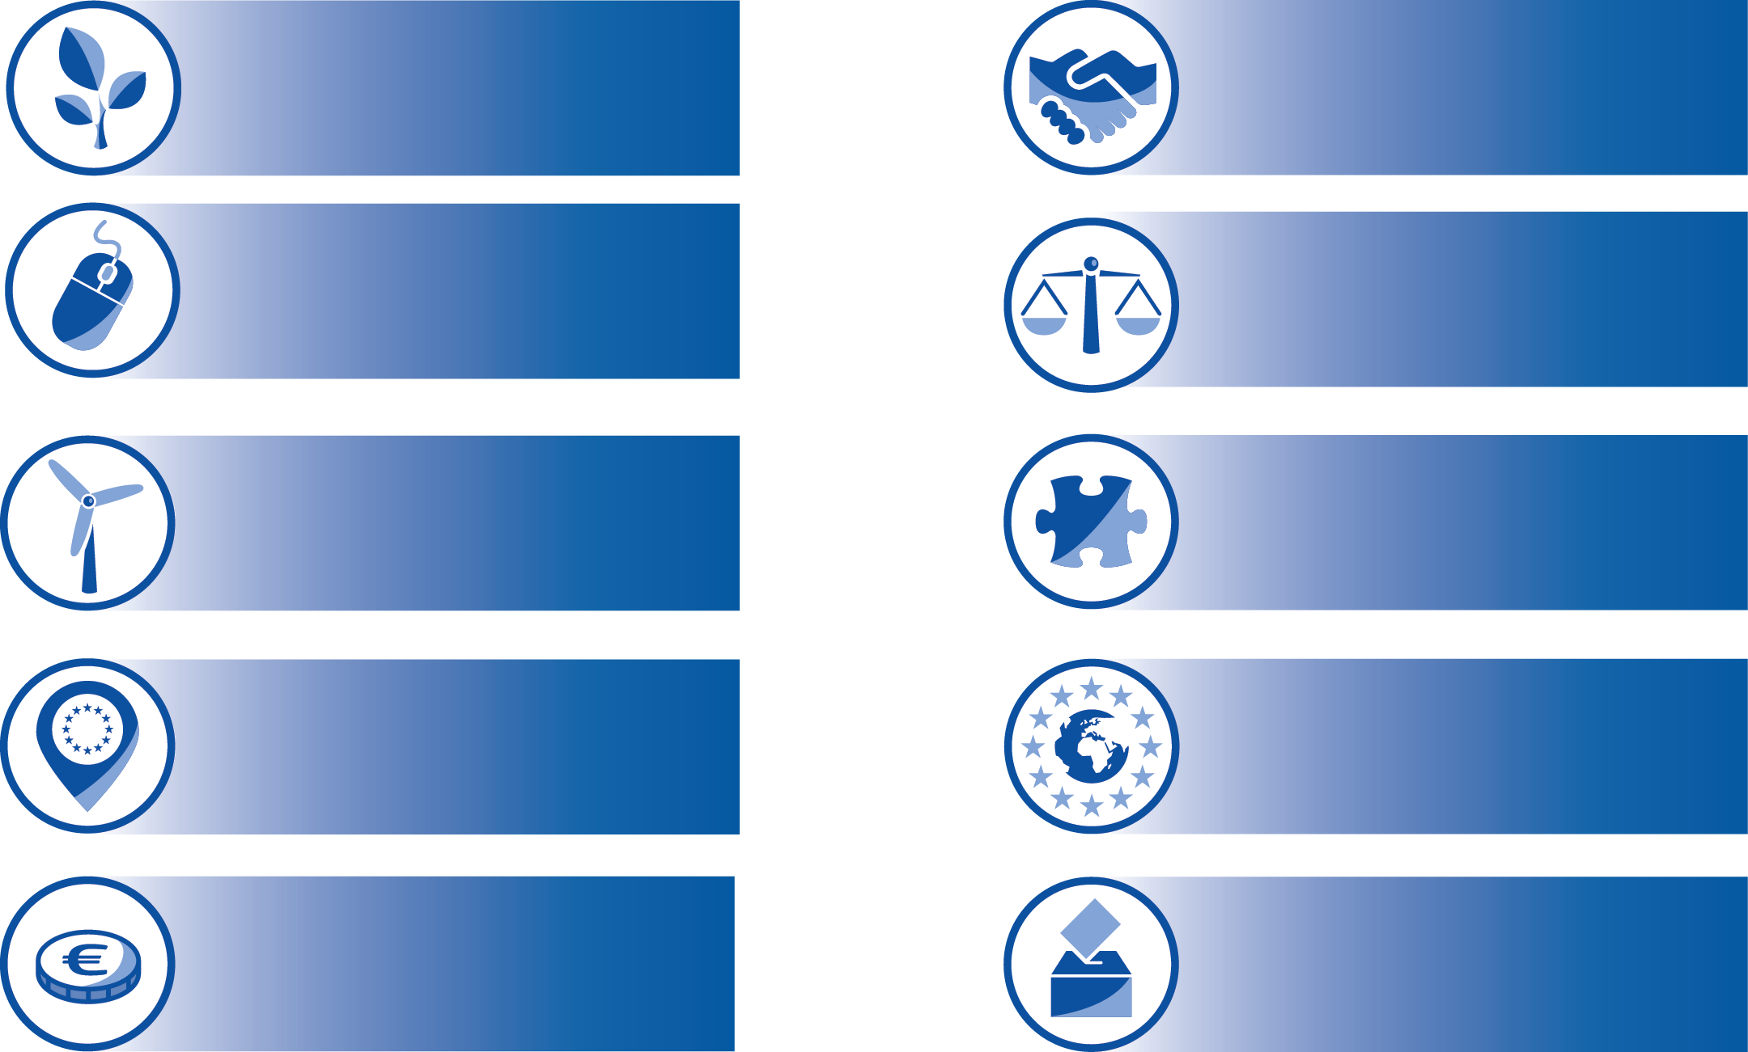
The 10 priorities
Jobs, growth,
investment
TTIP
Digital single
market
Justice &
fundamental rights
Energy Union
& climate
Migration
EU as a global
actor
Internal market
Economic &
Monetary Union
Democratic
change
Notes:
- To introduce Juncker's 10 priorities and to explain their coherence.
The 10 Priorities
The Commission focuses on 10 political priorities which reflect key challenges facing EU's economy and society.
The 10 priorities are the basis of Juncker's political agenda and together contribute to the overall goal of job creation, growth, fairness and democratic change.
The agenda emphasises concrete results in the 10 policy areas while leaving other policy areas to member countries where they are more legitimate and better equipped to act effectively at national, regional or local level.
Follow-up questions:
-> Do you know any actions which are executed by the Commission in the 10 priorities?

Slide 24
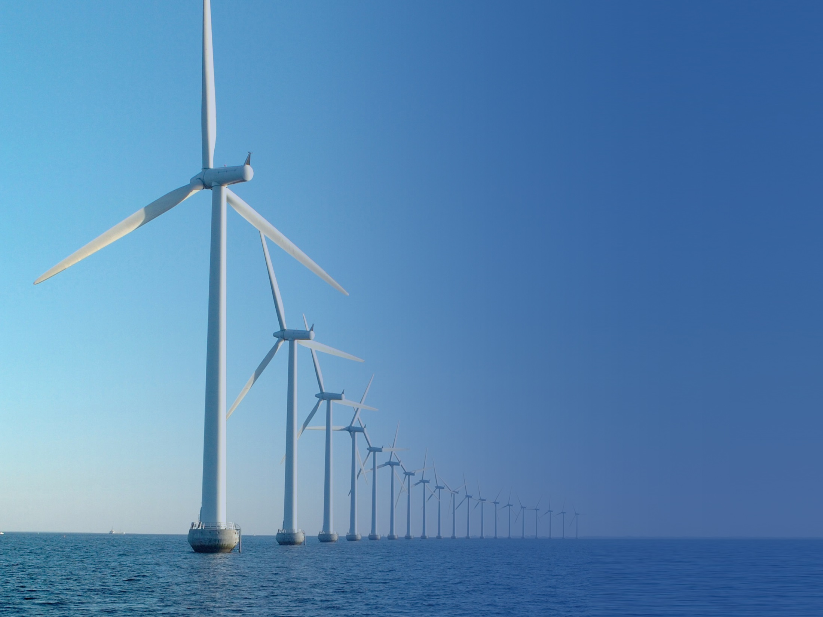
EUROPEAN COMMISSION
THE EU'S POLITICAL EXECUTIVE
JOBS, GROWTH, INVESTMENT

Slide 25
EUROPEAN COMMISSION
THE EU'S POLITICAL EXECUTIVE
JOBS, GROWTH, INVESTMENT

Slide 26
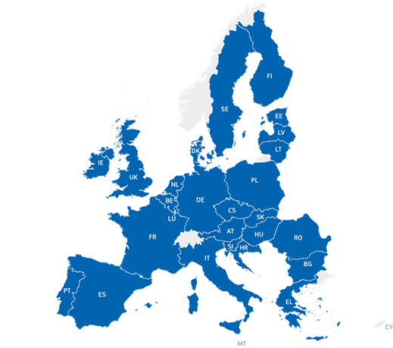
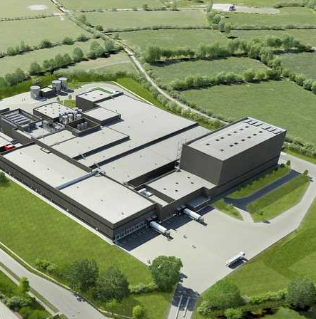
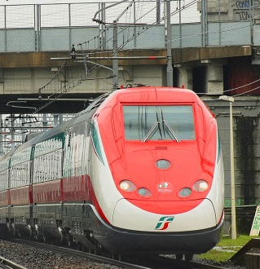
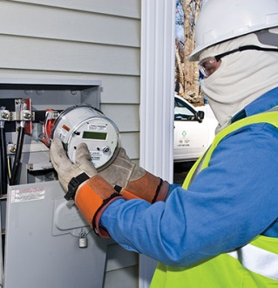
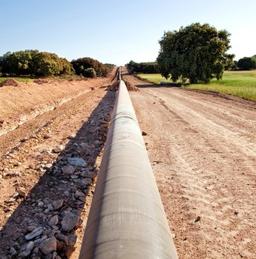
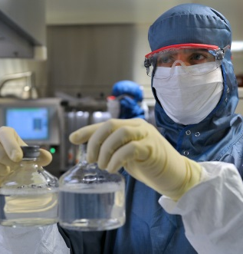
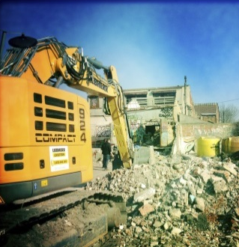
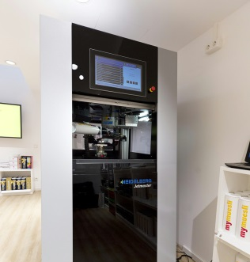
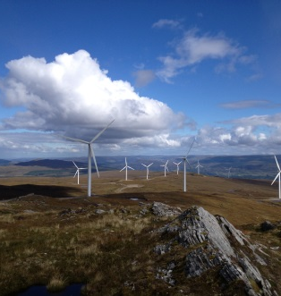
Jobs, Growth, Investment
324 projects financed by EFSI (September 2016)
Examples of projects
Notes:
Jobs, Growth and Investment
Stimulating investment for the purpose of job creation
Since the global economic and financial crisis, the EU has been suffering from low levels of investment. Collective and coordinated efforts at European level are needed to reverse this downward trend and put Europe on the path to economic recovery.
Investment Plan
The Investment Plan focuses on removing obstacles to investment, providing visibility and technical assistance to investment projects and making smarter use of new and existing financial resources.
- To achieve these goals, the plan is active in 3 areas:
1) mobilising investment of at least €315 billion in 3 years;
2) supporting investment in the real economy;
3) creating an investment-friendly environment.
Example: European Fund for Strategic Investments (EFSI)
The Investment Plan will be driven by the European Fund for Strategic Investment (EFSI)
A major aim of EFSI is to back projects that might otherwise have struggled to get competitive financing from private investors. That’s usually due to some risk, which dissuades private investment or makes projects less affordable.
The Investment Plan has the potential to add €330 to €410 billion to EU GDP and create 1 to 1.3 million new jobs in the coming years.
It can contribute greatly to the modernisation of European industry, but its success depends on participation by industry.
Projects financed by EFSI (June 2016):
Infrastructure and innovation projects: 78 (Financing under the EFSI: €11 bn)
SME financing agreements approved: 188 (Financing under the EFSI: €6.7 bn)
Total number of projects: 266
Total expected investment triggered: €106.8 bn
Country factsheets - Investment Plan state of play: http://ec.europa.eu/priorities/publications/country-factsheets-investment-plan-state-play_en
(number of projects, sectors, investment, etc.)
Follow-up question:
-> Do you know any projects financed by EFSI in your home country?

Slide 27
EUROPEAN COMMISSION
THE EU'S POLITICAL EXECUTIVE
DIGITAL SINGLE MARKET

Slide 28
EUROPEAN COMMISSION
THE EU'S POLITICAL EXECUTIVE
DIGITAL SINGLE MARKET

Slide 29
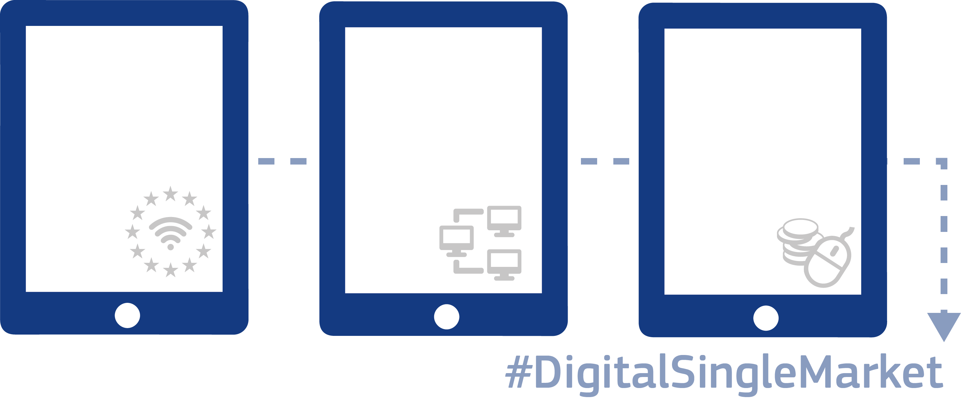
MORE INTEGRATED NETWORKS, PRODUCTS AND SERVICES
Access
Environment
Economy and Society
e-commerce
parcel delivery
geo-blocking
VAT
Telecoms and
media
Online platforms
Security and
personal
data
Data economy
Standards
Skills and
e-government
Creating a
Notes:
Digital Single Market
Bringing down barriers to unlock online opportunities
Europeans often face barriers when using online tools and services. This is even though the EU has spent decades bringing down those barriers "offline".
Fragmentation and barriers that do not exist in the physical single market are holding the EU back.
Markets are largely domestic in terms of online services. Only 7% of EU small- and medium-sized businesses sell cross-border. This needs to change – putting the single market online.
In a Digital Single Market, there are fewer barriers, and more opportunities: it is a seamless area where people and business can trade, innovate and interact legally, safely, securely, and at an affordable cost, making their lives easier.
The Digital Single Market could contribute €415 billion per year to the European economy, boosting jobs, growth, competition, investment and innovation.
It can expand markets and foster better services at better prices, offer more choice and create new sources of employment.
It can create opportunities for new start-ups and allow existing companies to grow and profit within a market of over 500 million people.
A completed Digital Single Market will also ensure that Europe maintains its position as a world leader in the digital economy, helping European companies to grow globally, and transforming our public services.
Example: More integrated networks, products and services:
- Improved access and a regulatory environment, economy and society that embrace digital realities – these are the three main strands of our action.
- Just to give a few examples: The Digital Single Market will provide better access for consumers and businesses to digital goods and services across Europe by unlocking e-commerce potential.
- With the same rules for e-commerce being applied in all EU Member States more and more companies would either start or increase their online sales to other EU countries.
- Affordable parcel delivery costs and convenient return options will be applied, allowing customers to easily return the shoes they bought if they are not the right size.
- Geographically based restrictions ("geo-blocking") will be tackled; meaning that the Commission aims to end unjustified geo-blocking which is incompatible with single market freedoms to trade and transact.
- VAT arrangements will be simplified and copyright rules modernised.
Major investment extends broadband services in eastern Poland
A major digital communications project in Swietokrzyskie, one of Poland’s less developed regions, has the potential to provide an additional 220 000 people with access to broadband services.
The construction of the broadband network infrastructure helps to eliminate the digital divide in areas that have previously been deprived of basic broadband services. The scheme brings Poland closer to reaching the objectives of the EU’s 11.
Digital Agenda for Europe in terms of basic broadband and Next Generation Access and provides the region with impetus to develop the digital economy.
The project is expected to generate about 500 jobs after implementation.
Digital education for Greek schoolchildren
New ICT infrastructure for primary and secondary schools will bring innovations in teaching materials and in the teaching process, ensuring a better digital education for Greek students.
Overall, more than 825 000 students, from primary schools to lyceums and institutes, will benefit from the project, representing 8 % of the overall Greek population. Furthermore, 24 jobs are expected to be created during the implementation of the project (Greece - “Attica”, “Central Macedonia – Western Macedonia – Eastern Macedonia & Thrace”, “Thessalia – Sterea Ellada – Ipiros”, and “Crete and the Aegean Islands”.
eEstonia
Estonia is one of the most advanced e-societies in the world. Its latest innovation is an e-residency card for non-nationals. Much of Estonia's e-government infrastructure has benefitted from investments under the European Regional Development Fund.
With the development of information society accessibility of the IT network will be improved, especially for people with special needs.
The transparency of decision procedures in municipal and central government level will be improved, giving people the possibility to participate in the process.
Quality of e-services in the public sector will be improved.
Follow-up question:
What kind of online barriers did you have to face?

Slide 30
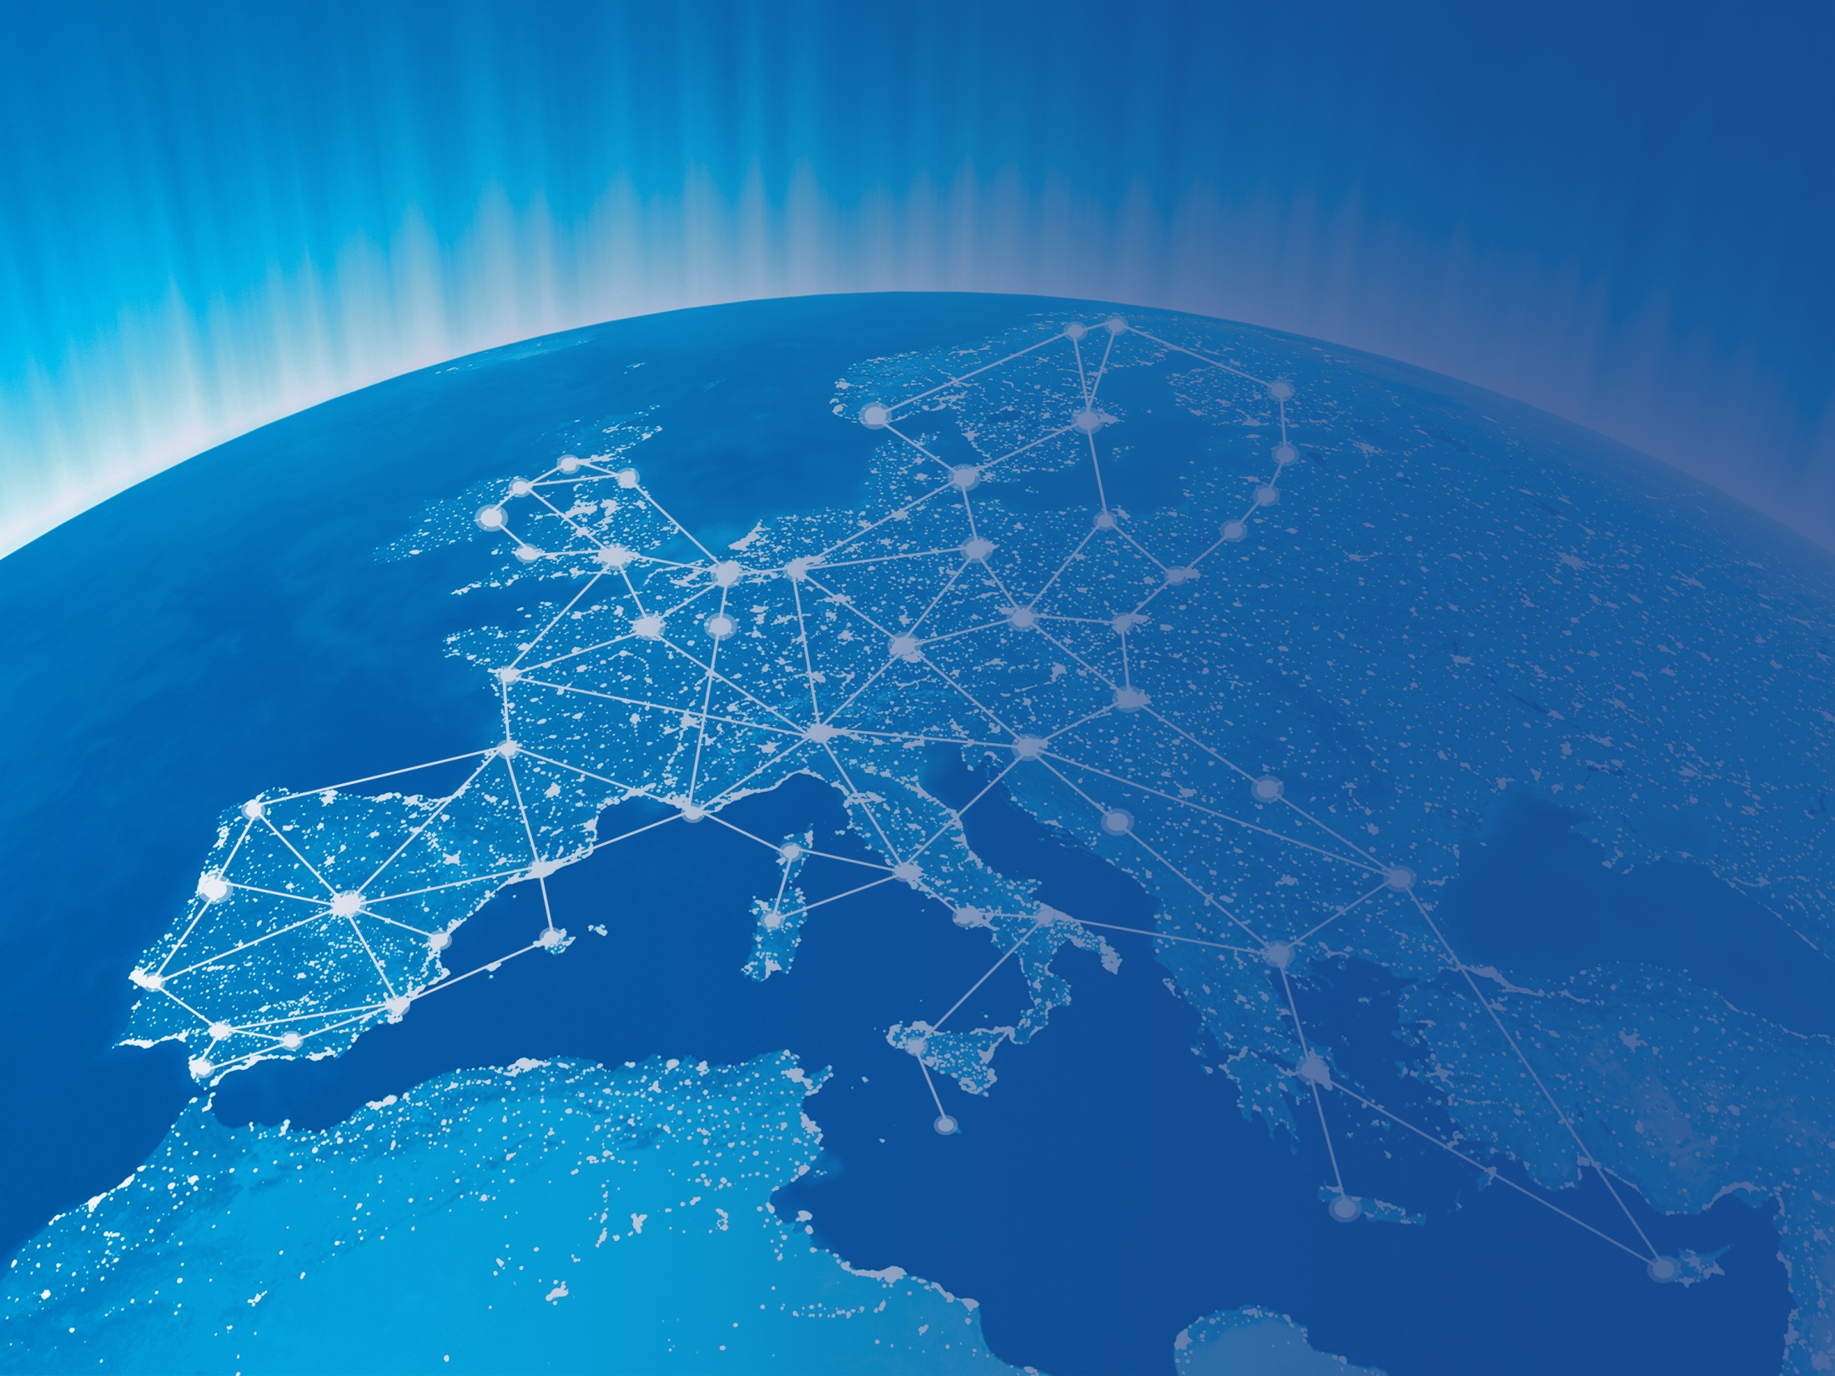
EUROPEAN COMMISSION
THE EU'S POLITICAL EXECUTIVE
ENERGY UNION AND CLIMATE

Slide 31
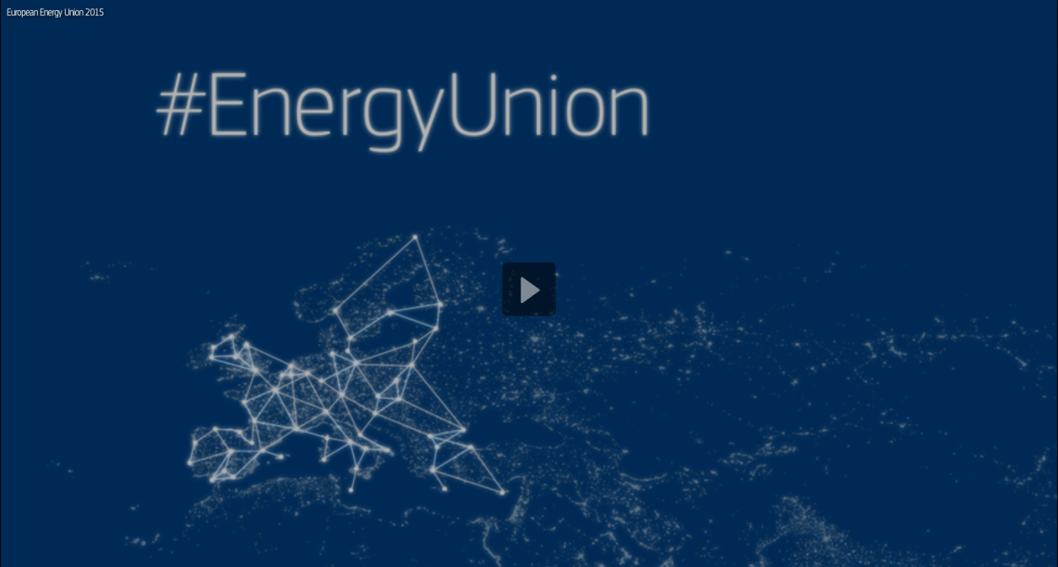
EUROPEAN COMMISSION
THE EU'S POLITICAL EXECUTIVE
ENERGY UNION AND CLIMATE

Slide 32
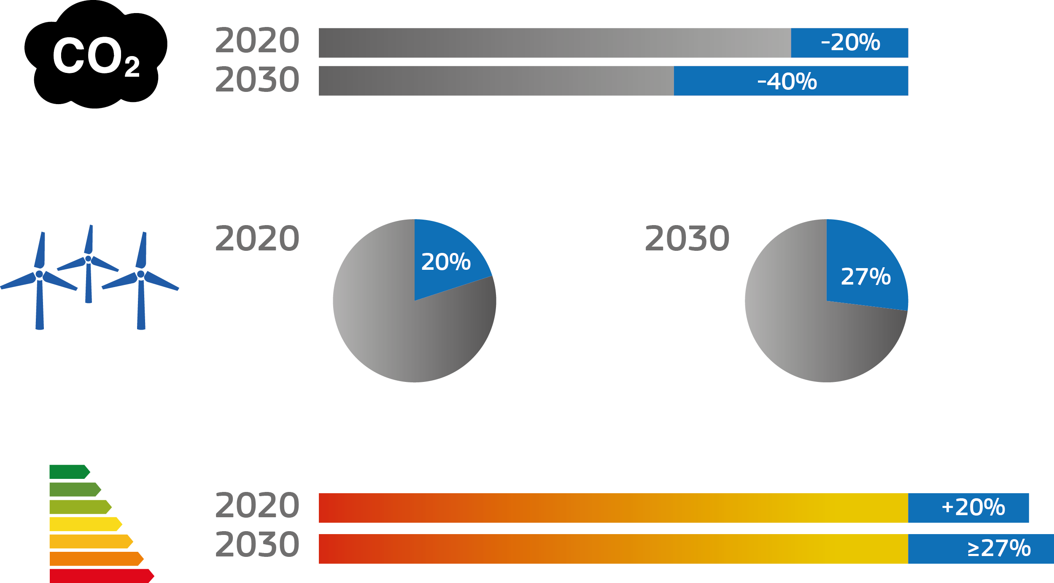
AN AMBITIOUS CLIMATE POLICY BY 2030
CUT GREENHOUSE GAS EMISSIONS BY AT LEAST 40%
INCREASE THE SHARE OF THE RENEWABLE IN THE ENERGY MIX TO 27%
IMPROVE ENERGY EFFICIENCY BY AT LEAST 27%
(Compared to the "Business-as-usual" scenario)
Notes:
Energy Union and Climate
Making energy more secure, affordable and sustainable
The Energy Union means making energy more secure, affordable and sustainable. It will allow a free flow of energy across borders and a secure supply in every EU country, for every European.
New technologies and renewed infrastructure will cut household bills and create new jobs and skills, as companies expand exports and boost growth. It will lead to a sustainable, low carbon and environmentally friendly economy, putting Europe at the forefront of renewable energy production and the fight against global warming.
Important groundwork has already been done. Europe has a policy framework for energy and climate for 2030, as well as an energy security strategy. Meanwhile, an integrated energy market for all EU countries is closer than ever before.
Objectives
Pool resources, connect networks and unite the EU's power when negotiating with non EU countries.
Diversify energy sources – so Europe can quickly switch to other supply channels if the financial or political cost of importing from the East becomes too high.
Help EU countries become less dependent on energy imports.
Reduce Europe's energy use by 27% or greater by 2030.
Build on the EU's target of emitting at least 40% less greenhouse gases by 2030.
Make the EU the world number one in renewable energy and lead the fight against global warming.
Example: ambitious climate policy by 2030:
The EU is the first region that made its ambitions targets binding:
At least 40% reduction of greenhouse gas emissions by 2030 compared to the levels in 1990.
At least 27% of EU's energy consumption should be produced by 2030 from renewable energies.
Energy efficiency should increase by at least 27%.
- On the road to Paris Conference of the Parties (COP) 21 United Nations' conference on climate change, the EU is gearing up a climate and energy diplomacy in ongoing negotiations.

Slide 33
EUROPEAN COMMISSION
THE EU'S POLITICAL EXECUTIVE
INTERNAL MARKET

Slide 34
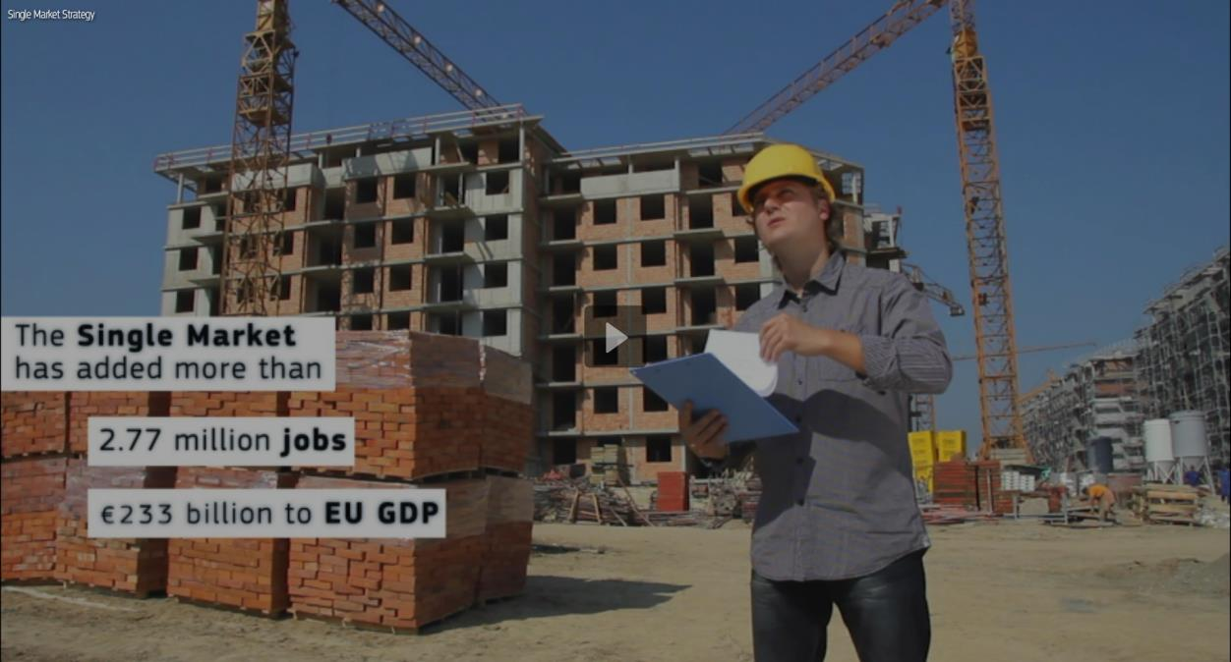
EUROPEAN COMMISSION
THE EU'S POLITICAL EXECUTIVE
INTERNAL MARKET

Slide 35
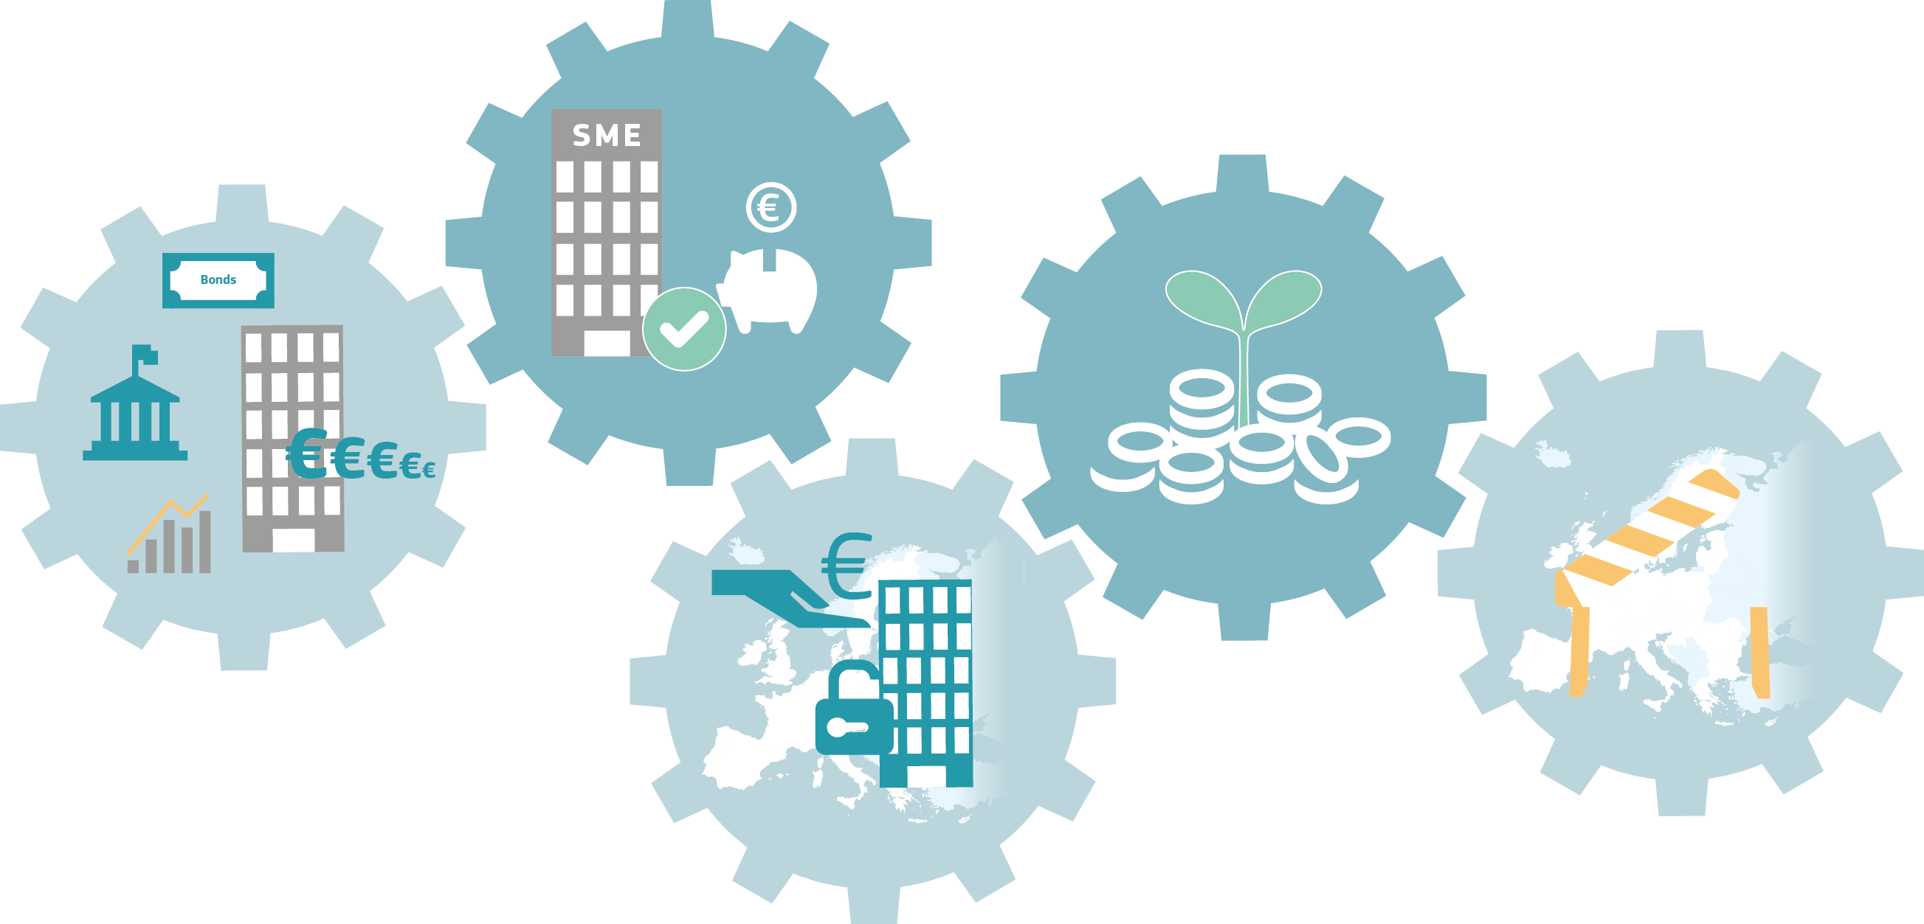
UNLOCKING FUNDING FOR EUROPE'S GROWTH
Improve funding for SMEs
Offer businesses a greater choice of funding at lower cost
Complement bank financing with other sources of capital
Remove obstacles to investing across borders
Give savers more investment choices
Notes:
Internal Market
A deeper and fairer internal market
The Single Market is one of Europe’s major achievements and its best asset in times of increasing globalisation. It is an engine for building a stronger and fairer EU economy. By allowing people, goods, services and capital to move more freely it opens up new opportunities for citizens, workers, businesses and consumers - creating the jobs and growth Europe so urgently needs.
More integrated and deeper capital markets will channel more funding to companies, especially SMEs, and infrastructure projects. Better worker mobility will let people move more freely where their skills are needed. And combatting tax evasion and tax fraud will ensure that all contribute their fair share.
Objectives
Completing the internal market in products and services and making it the launch pad for our companies and industry to thrive in the global economy.
Stimulating investment in new technologies, improving the business environment, easing access to markets and to finance, particularly for SMEs, and ensuring that workers have the skills industry needs.
Creating a Capital Markets Union, making it easier for small businesses to raise money and making Europe a more attractive place to invest.
Encouraging workers to take up jobs in other EU countries to fill vacancies and meet the need for special skills.
Reviewing the Posting of Workers Directive and ensure its strict implementation, to prevent social dumping.
Spurring administrative cooperation among national tax authorities.
Working for the adoption of a common consolidated corporate tax base and a financial transaction tax at EU level.
Example: Unlocking Funding for Europe's growth
- Capital Markets Union means unlocking Funding for Europe's growth:
- The objective of the Capital Markets Union is to diversify and expand the sources of financing for the economy, not to reduce the role of banks. Banks are and will remain an important source of financing for companies in the EU.
Unlocking this capital means savers and institutional investors get more investment choices and businesses a greater choice of funding at a lower cost.
A genuine single market for capital in the EU means that investors will be able to invest without unjustified obstacles across borders and with effective investor protection. Businesses will be able to raise the required funds from a diverse range of sources – irrespective of their location.
That means: The Capital Markets Union will also strengthen the link between savings and growth.

Slide 36
EUROPEAN COMMISSION
THE EU'S POLITICAL EXECUTIVE
ECONOMIC AND MONETARY UNION

Slide 37
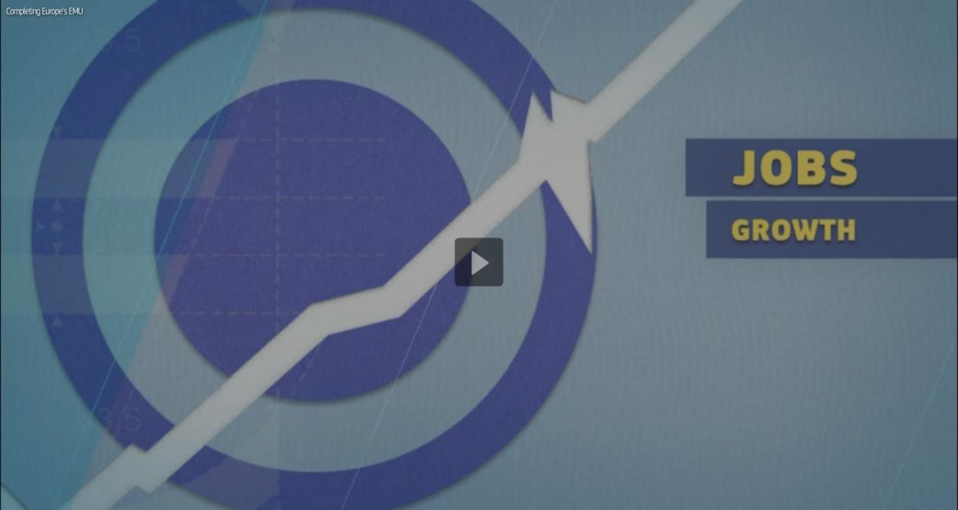
EUROPEAN COMMISSION
THE EU'S POLITICAL EXECUTIVE
ECONOMIC AND MONETARY UNION

Slide 38
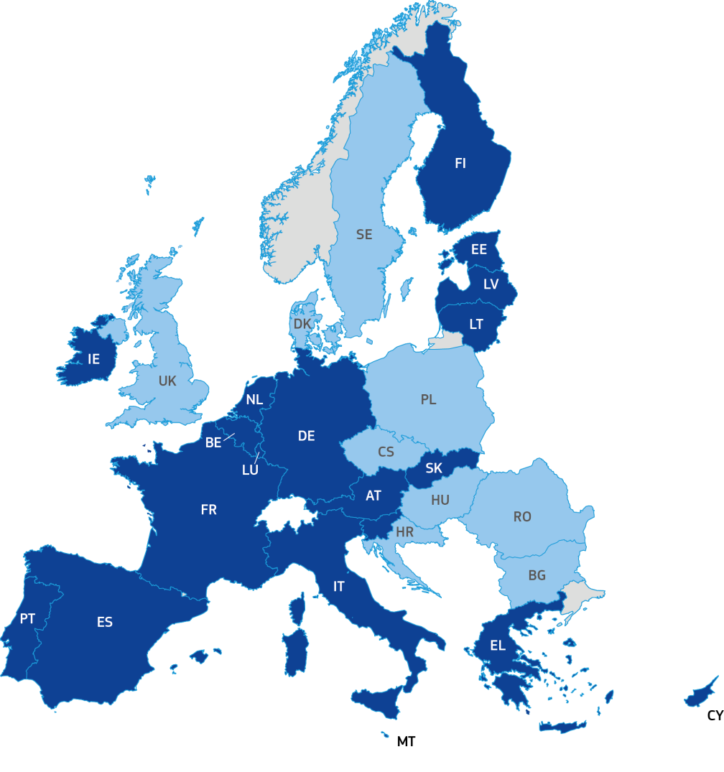
THE EURO IS MORE THAN JUST A CURRENCY
Member States in the Eurozone
Member States not in the Eurozone
1.
ECONOMIC
UNION
2.
FINANCIAL UNION
3.
FISCAL
UNION
4.
POLITICAL
UNION
Notes:
A Deeper and Fairer Economic and Monetary Union
Combining stability with fairness and democratic accountability
Delivering a deeper and fairer Economic and Monetary Union is one of the top 10 priorities of President Juncker in his Political Guidelines. The Five Presidents’ Report, presented on 22 June 2015, is the basis for achieving this aim within the next decade.
The report was prepared at the request of the Summit of euro area leaders of October 2014 and the European Council of December 2014.
Economic governance in the EU is organised annually in a cycle, known as the European Semester. The Annual Growth Survey is the first step in this cycle. It has been reinforced and refined over time, evolving in the context of historical developments. The Commission's work on Economic and Monetary Union is the latest step in this process.
Example: The euro is more than just a currency
The euro is - despite the recent crisis- the second most important currency in the world with a share of almost a quarter of global foreign exchange reserves, and with almost sixty countries and territories around the world either directly or indirectly pegging their currency to it.
The euro is more than a currency shared by 19 EU Member States and more than 330 million citizens. It has created a "community of destiny": this requires both solidarity in times of crisis and responsibility by all, in the sense of respect of commonly agreed rules.
Progress must happen on four fronts:
First, towards a genuine Economic Union that ensures each economy has the structural features to prosper within the Monetary Union.
In the EMU, monetary policy is centralised, but important parts of the economic policy remain national. However, as the crisis made particularly visible, euro area members depend on each other for their growth.
It is in each member's common and self-interest to be able to cushion economic shocks well, to modernise economic structures and welfare systems, and to make sure that citizens and businesses can adapt to and benefit from new demands, trends and challenges.
Second, towards a Financial Union that guarantees the integrity of our currency across the Monetary Union and increases risk-sharing with the private sector. This means completing the Banking Union and accelerating the Capital Markets Union.
Third, towards a Fiscal Union that delivers both fiscal sustainability and fiscal stabilisation.
And finally, towards a Political Union that provides the foundation for all of the above through genuine democratic accountability, legitimacy and institutional strengthening.
All four Unions depend on each other. They must develop in parallel and all euro area countries must participate in all Unions.

Slide 39
EUROPEAN COMMISSION
THE EU'S POLITICAL EXECUTIVE
TTIP

Slide 40
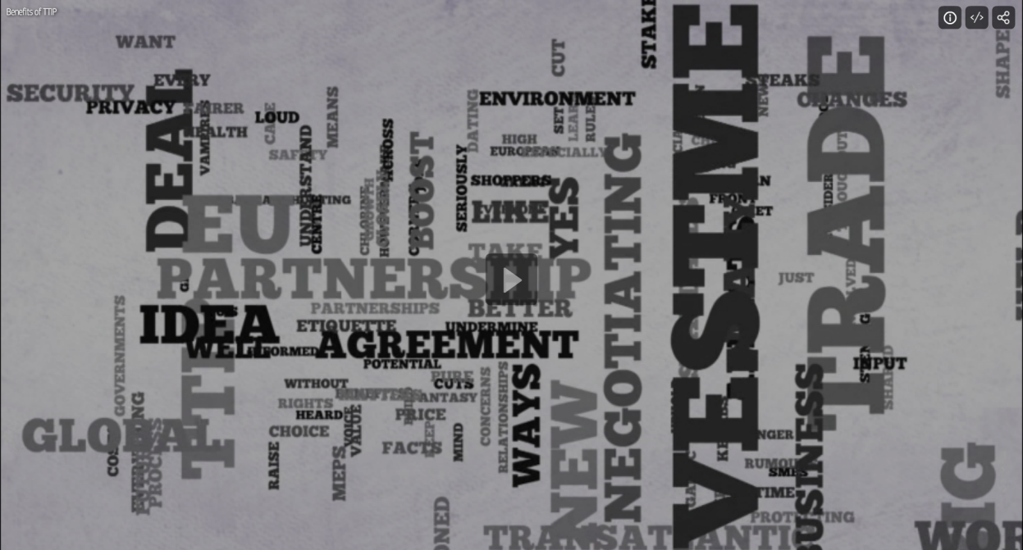
EUROPEAN COMMISSION
THE EU'S POLITICAL EXECUTIVE
TTIP

Slide 41
A BOOST FOR THE WORLD’S STRONGEST ECONOMIC PARTNERSHIP
The EU exports around €311 bn in goods and €159 bn in services to the US
The US was the leading investor in the EU with €1,652 bn
The EU imports around €205 bn in goods and €146 bn in services from the US
The US was the leading destination of EU Foreign Direct Investment stocks with €1,687 bn
World GDP
45%
World imports
32%
World exports
26%
The EU and the US accounted together for about half the entire world GDP, a third of the world imports and over a quarter of the world exports.
EU/US
EU/US
EU/US
Source: Eurostat
Notes:
A balanced EU-US Free Trade Agreement
Freer trade – without sacrificing Europe’s standards
The EU and the US have the largest bilateral trade relationship worldwide.
The two economies together account for about half the entire world's GDP and nearly a third of world trade flows. The US is the EU's top export market.
The EU exports around €310 billion in goods (2014) and €160 billion in services (2013) to the US. And in 2013 the US was the leading investor in the EU with €1,650 billion in investment stocks.
Yet today, regulations, red tape and non-tariff barriers between the EU and the US remain high.
Estimates show that 80% of the overall potential wealth gains of a trade deal will come from cutting administrative costs and from liberalising trade in services and public procurement.
On 14 June 2013, EU governments unanimously gave the European Commission a mandate to negotiate a Transatlantic Trade and Investment Partnership with the United States.
Getting TTIP right means being as transparent as possible. These talks are the most open ever for a trade deal. And the Commission is ensuring that negotiations take place in a spirit of mutual trust and transparency.
The EU will protect its high standards for food safety, consumer and environmental rules, privacy, healthcare, social protection, and cultural diversity. The European Parliament and EU governments – whose right to regulate is unaffected – are closely involved in negotiations. Businesses, environmental groups, trade unions and consumer organisations are duly consulted.
The negotiation of this agreement with the US is part of the Commission's new trade and investment strategy, which aims to deliver a more effective and responsible trade policy.
Example: A boost for the world’s strongest economic partnership
The Transatlantic Trade and Investment Partnership (TTIP) will boost the strongest economic partnership in the world.
For the European economy, it would mean more jobs, lower barriers, real benefits to consumers, and an easier route for EU businesses to export to, or get investment from, the US.
More exports would mean more demand for labour. About 30 million jobs in the EU depend on sales to the rest of the world, an increase of 10 million jobs since 1995.
It would be particularly beneficial to Small and Medium-sized Enterprises (SMEs) which account for a third of European exports to the US.
While SME exports to the US in 2012 accounted for 28% of all EU exports there, a significant number of EU SMEs still struggle to export to the US.

Slide 42
EUROPEAN COMMISSION
THE EU'S POLITICAL EXECUTIVE
JUSTICE AND FUNDAMENTAL RIGHTS

Slide 43
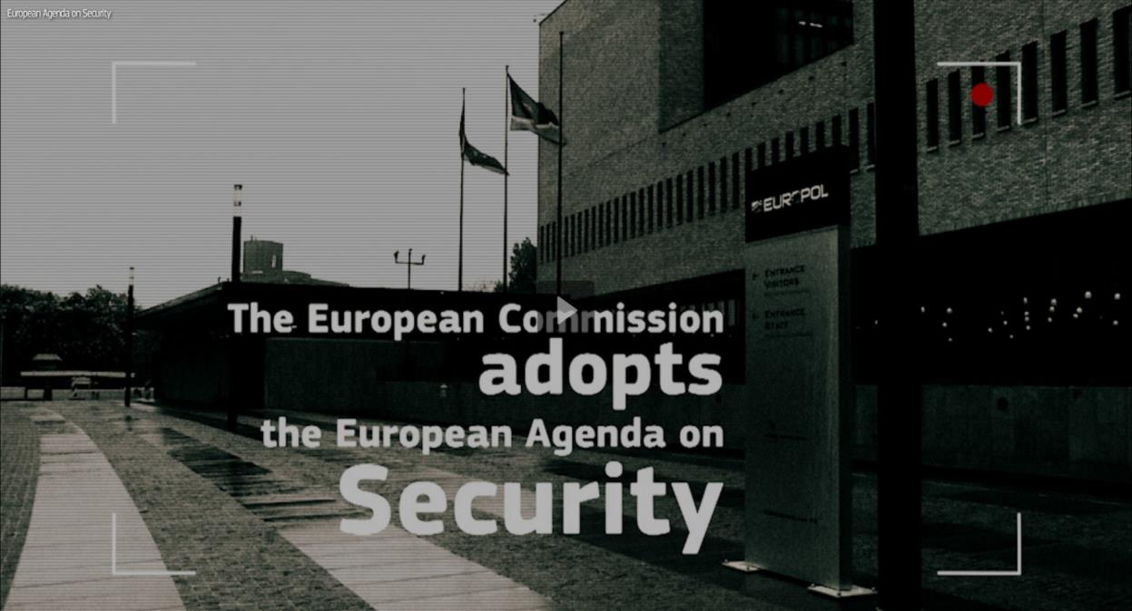
EUROPEAN COMMISSION
THE EU'S POLITICAL EXECUTIVE
JUSTICE AND FUNDAMENTAL RIGHTS

Slide 44
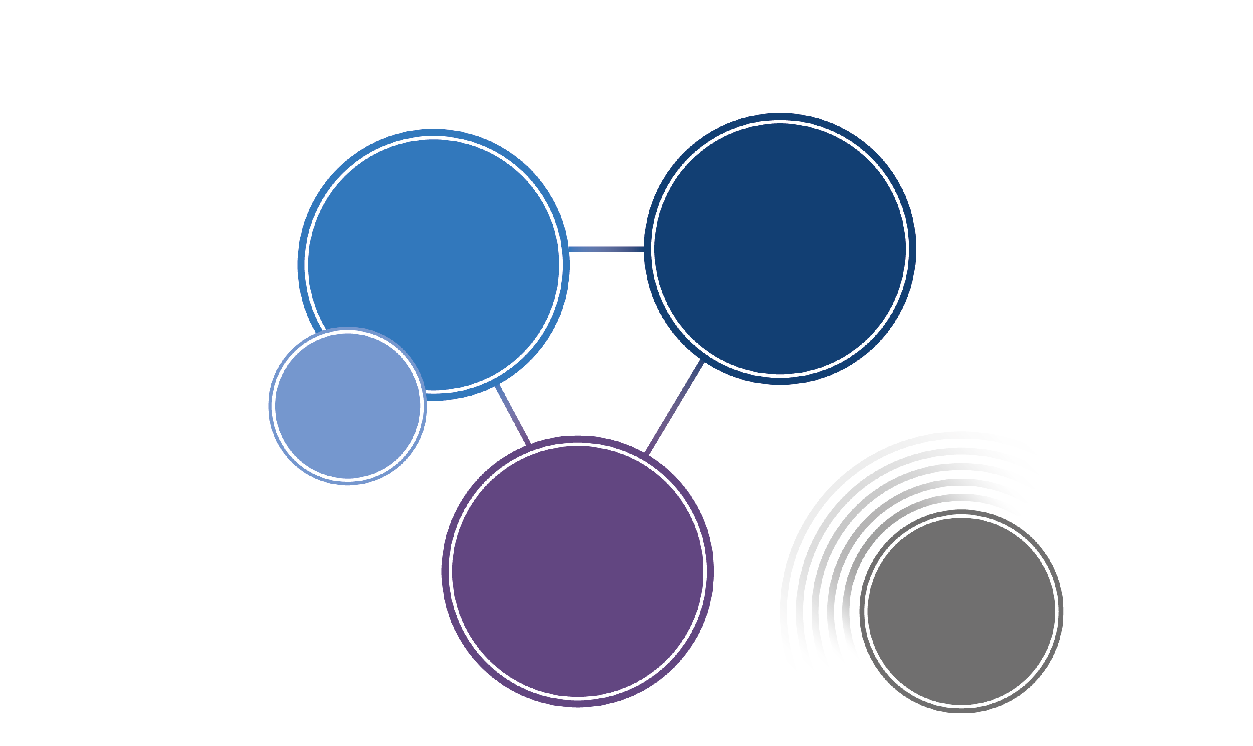
TRANSNATIONAL THREATS
Up to 5 000 foreign fighters from Europe
10 000
registered victims of human trafficking each year
TERRORISM
AND
RADICALISATION
ORGANISED
CRIME
RETURNING
FOREIGN
FIGHTERS
CYBERCRIME
SPILLOVER
EFFECTS
OF POLITICAL
INSTABILITY IN
EUROPE'S
NEIGHBOURHOOD
8%
of internet users are victims of online banking fraud
Notes:
Justice and Fundamental Rights
Upholding the rule of law and linking up Europe’s justice systems
The EU is not simply a common market for goods and services. Europeans share values that are spelled out in the EU Treaties and the Charter of Fundamental Rights. We must never lose sight of those values in our efforts to fight terrorism, human trafficking, smuggling and cybercrime.
We want to make life easier for Europeans who study, work or get married in other EU countries. One of our main goals is therefore to build bridges between the different national legal systems across the EU. A borderless and seamless European justice area will ensure that citizens can rely on a set of rights all across the continent.
Objectives
Making it easier for citizens and companies in the EU to defend their rights outside their home country, by improving mutual recognition of judgments by courts across the EU.
Cracking down on organised crime, such as human trafficking, smuggling and cybercrime and tackling corruption;
Concluding the accession of the EU to the Council of Europe's Convention of Human Rights.
Obtaining guarantees that US government agencies and companies adequately protect EU citizens' personal data.
Pushing for an EU-wide law against discrimination.
Example: Transnational threats
- Recent terrorist attacks in Europe testify to the increasing menace of violent extremism and the influence that crisis and conflicts in Syria, Iraq and Libya have on radicalising European citizens.
- Organised crime networks exploit gaps in enforcement and action across border.
- Cybercrime offers a huge potential gains to criminals, as commerce and baking shift online. The online environment has become an increasing target for criminals, including child sexual abusers.
- The European Agenda on Security 2015-2020 presented by the Commission in April 2015 clearly identifies terrorism, organised crime and cybercrime as interlinked threats with a strong cross-border dimension where action at European level can make a real difference.
- The Agenda is the basis for cooperation and joint action by the Union on security in the next five years with the aim to develop a genuine area of EU internal security.
- Success relies on better and closer cooperation between EU institutions and agencies - notably the European Union’s law enforcement agency Europol and the European Union's Judicial Cooperation Unit, Eurojust – and Member States; on the full use of the existing tools.
- The Agenda will enable a better use of these tools by:
- Intensifying information exchange between law enforcement authorities and EU agencies,
- Strengthening operational police cooperation.
- Boosting training and co-funding for security at EU-level

Slide 45
EUROPEAN COMMISSION
THE EU'S POLITICAL EXECUTIVE
MIGRATION

Slide 46
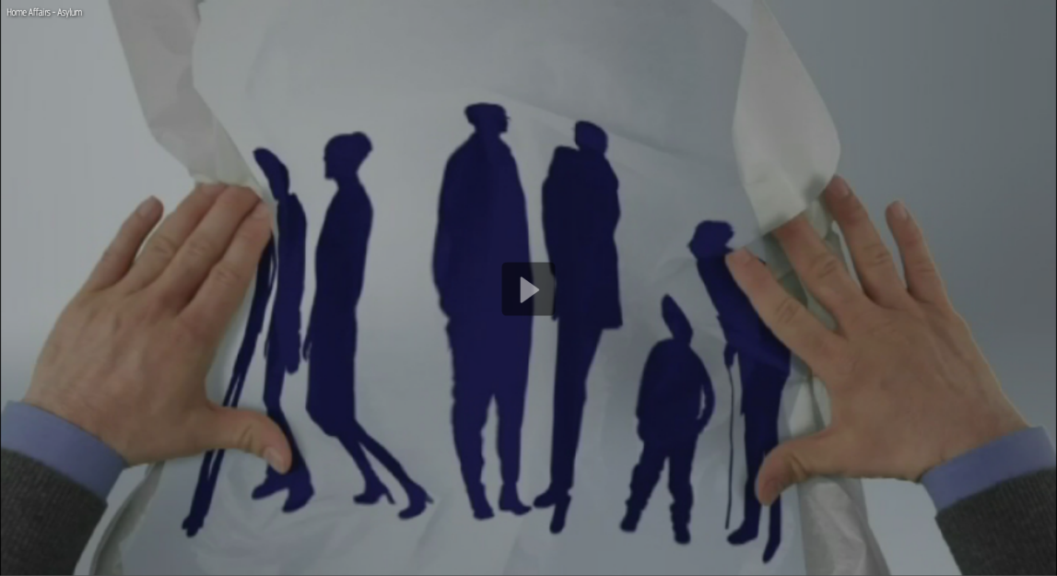
EUROPEAN COMMISSION
THE EU'S POLITICAL EXECUTIVE
MIGRATION

Slide 47
Tripling
the EU budget for
search and rescue
mission at sea
Building hotspots
in Greece and Italy
to register and
identify arrivals
New proposals for a
European border and
coast guard to support
Member States
An emergency relocation
scheme for all Member
States to contribute
to the asylum process
Emergency funding
for humanitarian efforts
within EU
Financial and
practical support to
return operations for
failed applicants
Trust funds for Syria and
Africa to tackle the economic
and political causes of
migration
An agreement with
Turkey to share the
responsibility for
providing international
protection
Coordination with the
Western Balkans to manage
borders and deliver
humanitarian assistance
Notes:
Migration
Towards a European agenda on Migration
The plight of thousands of migrants putting their lives in peril to cross the Mediterranean has shocked. It is clear that no EU country can or should be left alone to address huge migratory pressures.
The European Commission's agenda on migration sets out a European response, combining internal and external policies, making best use of EU agencies and tools, and involving all actors: EU countries and institutions, international organisations, civil society, local authorities and national partners outside the EU.
Background
Migration is one of the political priorities of the Juncker Commission. The main aim is to approach the issue in a comprehensive way.
The Commission's agenda on migration defines immediate measures needed to prevent human tragedies and to strengthen emergency responses.
And while the crisis in the Mediterranean has put the spotlight on immediate needs, it has also revealed much about the structural limitations of EU migration policy and tools.
The EU needs to strike the right balance and send a clear message to Europeans that migration can be better managed collectively. This is why the agenda also defines a new strategic approach to managing migration in the medium to long term.
Example: actions within the priority
A 'hotspot' is a section of the EU external border or a region with extraordinary migratory pressure which calls for EU support.
To implement the 'hotspot' approach, Member States have committed to send more experts to Frontex and EASO.
A relocation scheme
Following the Commission's proposal 160,000 asylum seekers will be relocated from Member States on the frontline, notably Italy and Greece, to other EU Member States.
Member States must appoint national contact points and liaison officers to make the relocation scheme work.
Learning the lessons of the current crisis and to allow us to deal with crisis situations more swiftly in the future, the Commission has proposed a permanent relocation mechanism which could be triggered for any EU Member State facing an emergency situation.
- Financial support
On the financial front, the Commission has already mobilised more EU funding in support of those Member States most affected – allocating over €75 million in emergency funding, on top of the €7 billion in multiannual funding allocated to Member States over the period from 2014-20 to support their efforts in the field of migration and border management.
EU-Turkey Agreement
On 18 March 2016, EU Heads of State or Government and Turkey agreed to end the irregular migration from Turkey to the EU and replace it instead with legal channels of resettlement of refugees to the European Union. The aim is to replace disorganised, chaotic, irregular and dangerous migratory flows by organised, safe and legal pathways to Europe for those entitled to international protection in line with EU and international law.
Meeting on the Western Balkans Migration Route: Leaders Agree on 17-point plan of action
On 25 October 2015, Leaders representing Albania, Austria, Bulgaria, Croatia, the former Yugoslav Republic of Macedonia, Germany, Greece, Hungary, Romania, Serbia and Slovenia met in Brussels at the Commission's Berlaymont Headquarters and agreed on a 17-point plan of action to improve cooperation and step up consultation between the countries along the route and decided on pragmatic operational measures that can be implemented to tackle the refugee crisis in the region.
Trust Fund for Syria
The shortfall in funding for the Syria crisis is partly the direct cause of the increased flows of refugees in the Eastern Mediterranean.
The European Union is already the number one donor in the global efforts to alleviate the Syrian refugee crisis. So far, around €4 billion have been mobilised by the European Commission and Member States in humanitarian, development, economic and stabilisation assistance to Syrians in their country and to refugees and their host communities.
The European Commission will immediately increase its humanitarian aid in third countries by €200 million in 2015 to provide immediate resources to respond to the needs of the UNHCR and the World Food Programme and other relevant organisations in order to help refugees immediately. And the humanitarian aid budget will be increased by an extra €300 million in 2016. Member States should restore funding for food via the World Food Programme to 2014 level.
On 15 December 2015, the European Commission adopted an important set of measures to manage the EU's external borders and protect our Schengen area without internal borders. The proposal will help to manage migration more effectively, improve the internal security of the European Union, and safeguard the principle of free movement of persons. The Commission is proposing to establish a European Border and Coast Guard to ensure a strong and shared management of the external borders. To further increase security for Europe's citizens, the Commission is also proposing to introduce systematic checks against relevant databases for all people entering or exiting the Schengen area.
The Commission has tripled the presence at sea. Thanks to this reinforced presence at sea, many more lives have been saved. As President Juncker said:" Every life lost is one too many, but many more have been rescued that would have been lost otherwise – an increase of 250%."

Slide 48
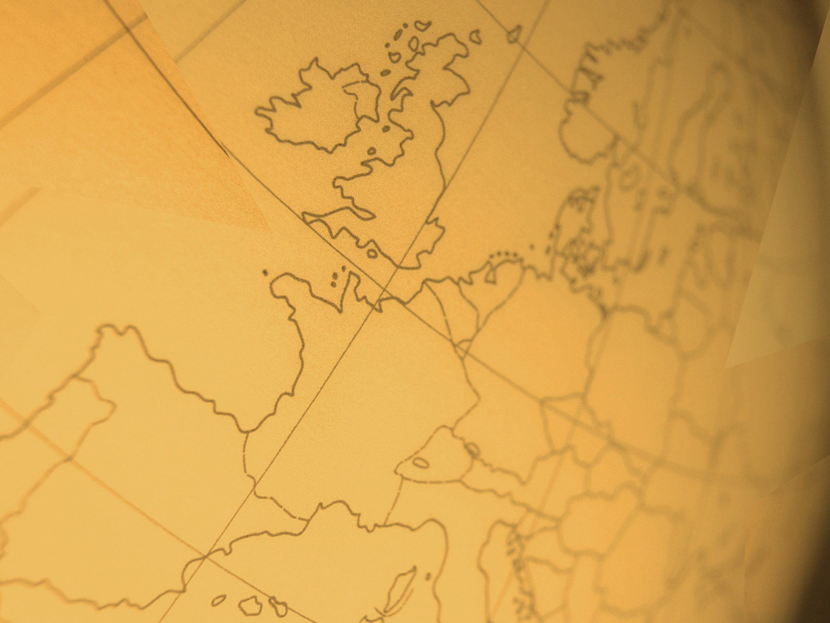
EUROPEAN COMMISSION
THE EU'S POLITICAL EXECUTIVE
EU AS A GLOBAL ACTOR

Slide 49
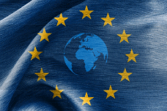
EUROPEAN COMMISSION
THE EU'S POLITICAL EXECUTIVE
EU AS A GLOBAL ACTOR

Slide 50
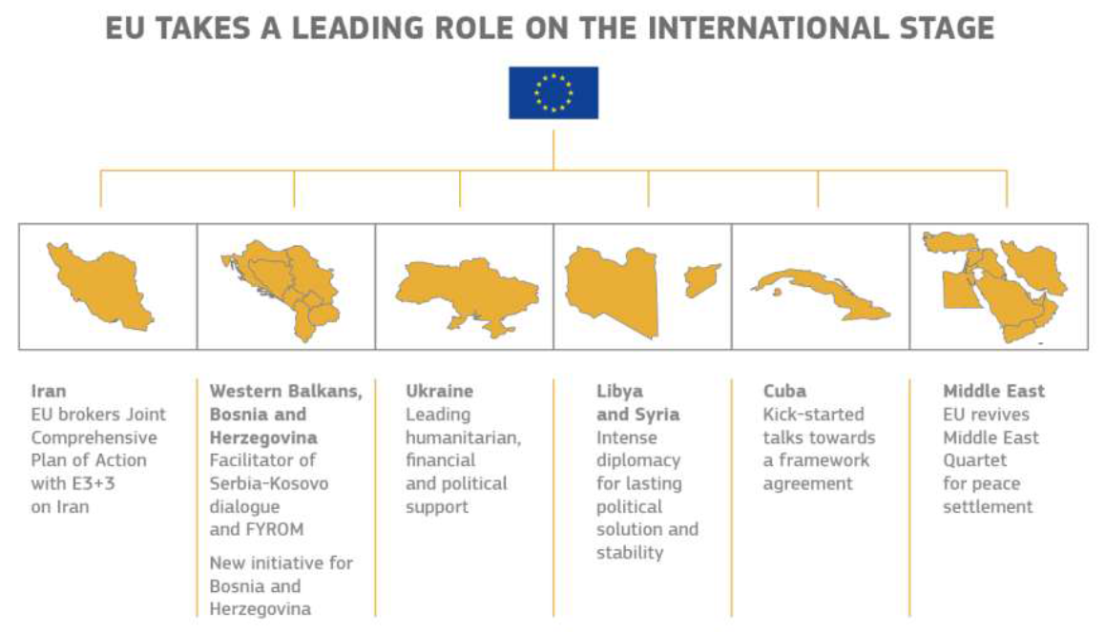
Notes:
The European External Action Service (EEAS) is the European Union's diplomatic service. Its role is to make sure the voice of the European Union and its people are heard in the world.
A key aspect of the work of the EEAS is its ability to work closely with the foreign and defence ministries of the 28 member states of the EU and the other EU institutions such as the European Commission, Council and Parliament. It also has a strong working relationship with the United Nations and other International Organisations.
Since late 2014, Italy's Federica Mogherini has been the EU's High Representative/Vice President. As the EU's chief diplomat she is charged with shaping and carrying out the EU's foreign and security policy – known as the "Common Foreign and Security Policy'" (CFSP) and the 'Common Security and Defence Policy' (CSDP).
Since the entry into force of the Lisbon Treaty the High Representative is also Vice-President of the European Commission. This allows her to coordinate and ensure coherence in EU foreign policy as the European Commission has important international responsibilities such as trade, development, neighbourhood policy and humanitarian aid. The combination of these roles is to ensure the consistency and coherence of EU activities in the world and ensure they do not conflict or overlap. They head the EU's diplomatic corps, the European External Action Service.
What does the High Representative/Vice-President do?
The role is wide-ranging. It involves:
- The overall steering of foreign policy and security policy on behalf of the EU;
- Coordinating the EU’s foreign policy tools – development, trade, neighbourhood policy, humanitarian aid and crisis response in her role as Vice-President of the European Commission;
- Building consensus between the 28 EU member states and their respective priorities – including through chairing monthly meetings between EU foreign ministers, defence ministers, trade and development ministers ;
- Attending regular meetings between EU leaders in the European Council;
- Speaking in debates at the European Parliament on foreign policy and security issues;
- Representing the EU at international meetings, such as the United Nations;
- Heading the European Defence Agency and the EU Institute for Security Studies.
Who appoints the High Representative/ Vice-President?
- The European Council, which comprises the heads of state or government of all EU member states, appoints the HR/VP through a 'qualified majority' vote. The President of the Commission must be in agreement with the decision.
- The High Representative also holds the role of Vice-President of the European Commission which is as a body voted on by the European Parliament before taking office.
- The Commissioners are appointed for a five-year term, which is renewable and which coincides with the five-year mandate of the European Commission.
Headquarters
The daily work of the EEAS is overseen by its Secretary-General Alain Le Roy who is assisted by three Deputy Secretaries-General: Christian Leffler, Helga Schmid and Pedro Serrano.
The EEAS is divided into both geographical and thematic directorates. Five large departments cover different areas of the world – Asia-Pacific, Africa, Europe and Central Asia, the Greater Middle East and the Americas. Separate departments cover global and multilateral issues which include, for example, human rights, democracy support, migration, development, response to crises and administrative and financial matters. The EEAS also has important Common Security and Defence Policy (CSDP) planning and crisis response departments. The EU Military Staff is the source of collective military expertise within the EEAS and also advises the High Representative / Vice-President on military and security issues.
EU Delegations
Following the Treaty of Lisbon, the EEAS is responsible for the running of EU Delegations and Offices around the world.
The 139 Delegations play a vital role in representing the EU and its citizens around the globe and building networks and partnerships. The main role is to represent the EU in the country where they are based and to promote the values and interests of the EU.
They are responsible for all policy areas of the relationship between the EU and the host country – be they political, economic, trade or on human rights and in building relationships with partners in civil society. In addition they analyse and report on political developments in their host country. They also programme development cooperation through projects and grants. A fundamental aspect of a Delegation is its public diplomatic role which consists in increasing the visibility, awareness and understanding of the EU.
Delegations are diplomatic missions and are usually responsible for one country, although some are representatives to several countries. The EU also has Delegations to international organisations like the United Nations and the World Trade Organisation for example.

Slide 51
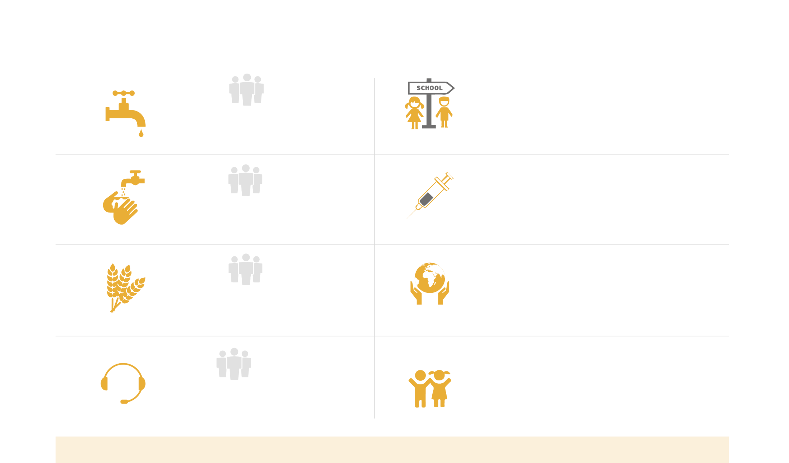
DEVELOPMENT: EU MAKING THE WORLD A BETTER PLACE
+ 74 M
13.7 M
new pupils
enrolled in primary education
connected to improved
drinking water
27.5 M
20 M
children
under the age of one immunised against measles
connected to sanitation
facilities
58.7 M
The EU has allocated € 12.7 M to Children of Peace projects around the world
assisted through food security related social transfers
8.8 M
In the DRC alone over 40 000 children formerly associated with armed groups, victims of violence or unaccompanied
minors have accessed education
benefited from employment related assistance
EU IS THE WORLD'S LARGEST AID DONOR WITH THE €58.2 BN CONTRIBUTION
Notes:
A Stronger Global Actor
Bringing together the tools of Europe’s external action
The political crisis in Ukraine, the situation in Syria, the unrest in the Middle East have made it clear that the EU needs a stronger common foreign policy. The EU has a wide range of 'soft power' tools – including trade policy and development aid, coordinated by Federica Mogherini, the High Representative of the Union for Foreign Affairs and Security Policy.
Beyond these tools, those national governments who wish should also pool their defence capabilities, enabling them to participate in joint EU missions – as well as to avoid duplication of programmes and to save money.
Besides foreign policy tools, the European Commission is committed to deliver relief aid to the most vulnerable people caught up in natural or man-made disasters. Assistance is provided via its humanitarian and civil protection tools.
Objectives
respond efficiently to global challenges, including the crises in its neighbourhood,
project its values, and
contribute to peace and prosperity in the world.
Example: Development - EU making the world a better place
In September 2015 the United Nations set out a global framework to eradicate poverty and achieve sustainable development by 2030, building on the Millennium Development Goals (MDGs) adopted in 2000.
15 years ago, the Millennium Development Goals, or MDGs, were put in place by the international community to reduce poverty and improve the lives of people in developing countries. The Millennium Declaration and the MDGs expire at the end of 2015.
The result is a landmark achievement uniting the whole world around common goals for a more sustainable future.
The 2030 Agenda includes an ambitious set of 17 Sustainable Development Goals (SDGs) and 169 associated targets.
The EU has been a leader in contributing to this process from the start.
The European Union and its Member States, together the world’s largest donor of Official Development Assistance (ODA), have helped make a difference to the lives of millions.
The Official Development Assistance (ODA) of the EU institutions and Member States reached €58.2 billion in 2014, the highest level to date.
Of that total, using its humanitarian aid and civil protection instruments, the EU provided substantial needs-based emergency assistance in 2014 for a total commitment of €1,273 million.

Slide 52
EUROPEAN COMMISSION
THE EU'S POLITICAL EXECUTIVE
DEMOCRATIC CHANGE

Slide 53
EUROPEAN COMMISSION
THE EU'S POLITICAL EXECUTIVE
DEMOCRATIC CHANGE

Slide 54
ВIG
BIG on ВIG things small on small things
Focus on
10 priorities
Taking a closer look at existing law
EU to serve citizens and businesses
Notes:
Democratic change
Making the EU more democratic
For the first time, in 2014, EU countries had to take the results of the elections into account when proposing a candidate for European Commission President.
Albeit an important step, this is only the first of many in making the European Union more democratic and bringing it closer to its citizens.
Europeans have the right to know who Commissioners and Commission staff, Members of the European Parliament and representatives of the Council meet in the context of the legislative process. The Commission is committed to bringing a new lease of life to the relationship with the European Parliament, as well as to working more closely with national parliaments.
Objectives
Creating a mandatory register for organisations and individuals lobbying the Commission, Parliament and Council.
Working with the European Parliament and the Council to remove unnecessary red tape at both European and national level.
Finding ways to deepen cooperation between national parliaments and the Commission.
Reviewing the laws that oblige the Commission to authorise genetically modified organisms (GMOs), even when a majority of national governments is against this.
Increasing the number of women in management and other administrative positions in the Commission.
Example: Democractic change
The Commission is changing both what we are doing and how we do it. Being "big on big things – small on small things" is our guiding principle following President Juncker's Political Guidelines.
An Investment Plan for Europe to boost jobs and growth; an Energy Union to deliver secure, affordable and sustainable energy; an internal security agenda to tackle common threats like terrorism and organised crime; a Digital Single Market to unlock online opportunities; and a European Agenda on Migration. Our new initiatives flow from genuine political priorities. And before jumping on new initiatives, we are also taking a closer look at existing law to see if it is fit for purpose, and improve it where necessary.
The EU, its institutions and its body of law are there to serve citizens and businesses. The EU's job is to make life easier and not harder for businesses and citizens.
Better regulation and transparency have been entrusted to the First Vice-President of the Commission – Frans Timmermans. This is a clear signal of the political importance given by the Commission to this priority.

Slide 55
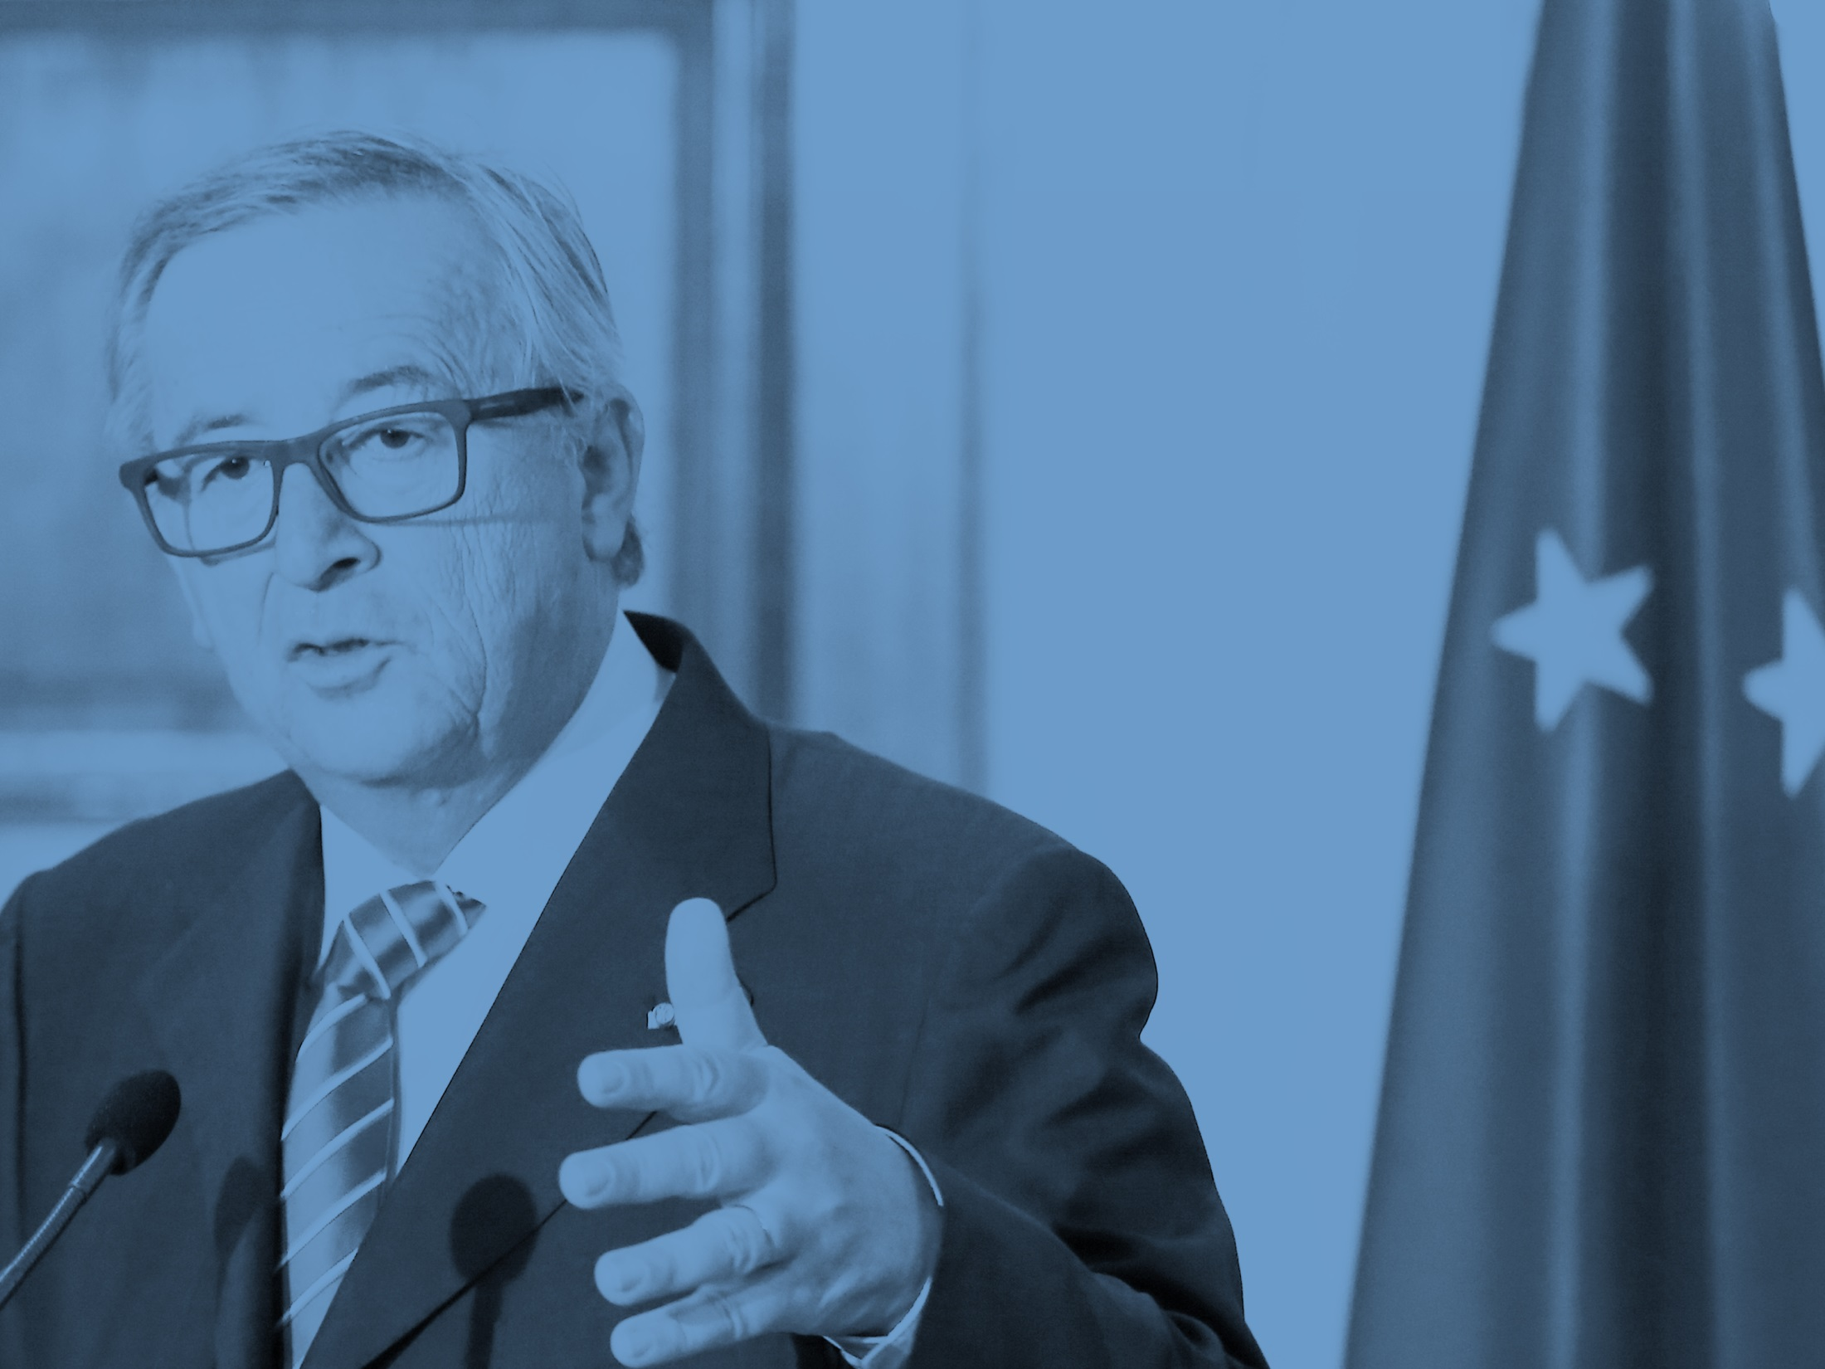
"We can only succeed as a Union. Collectively we are stronger than the challenges that confront us."
President Jean-Claude Juncker
Strasbourg, 9 September 2015
Notes:
- To conclude

